Slide 1




DATA MANAGER
PRESENTATION
Version 1.0

Slide 2

Data Manager Modules
Dashboard
Area
Sector
Indicator
Indicator Metadata
Data Entry
Data Approve
Entity Registration
Resource
Access Control
Logs

Slide 3
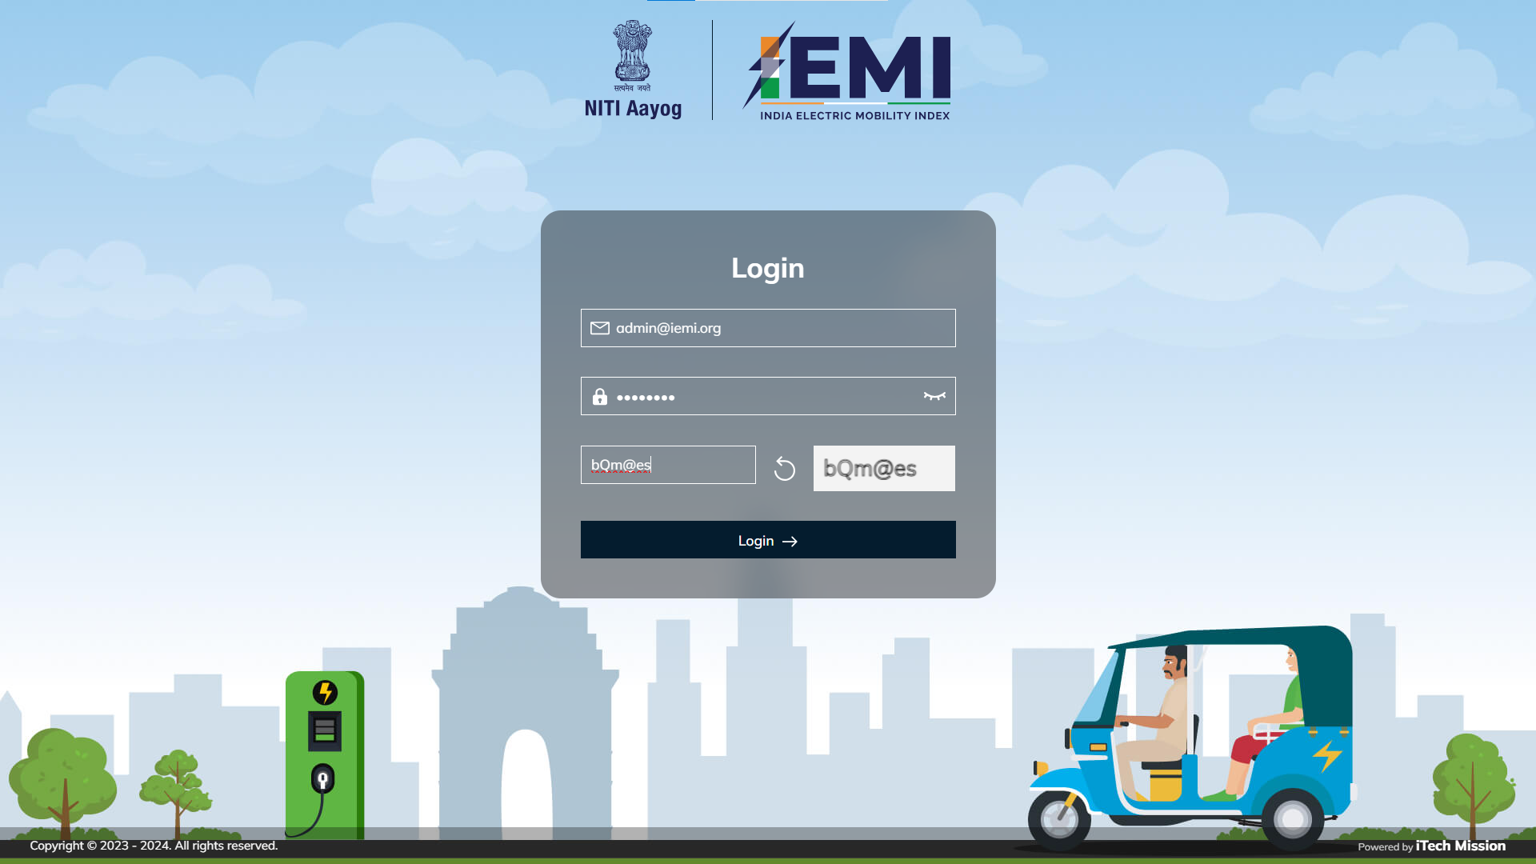

LOGIN
Login using valid credentials to access data manager modules

Slide 4

1
Dashboard

Slide 5
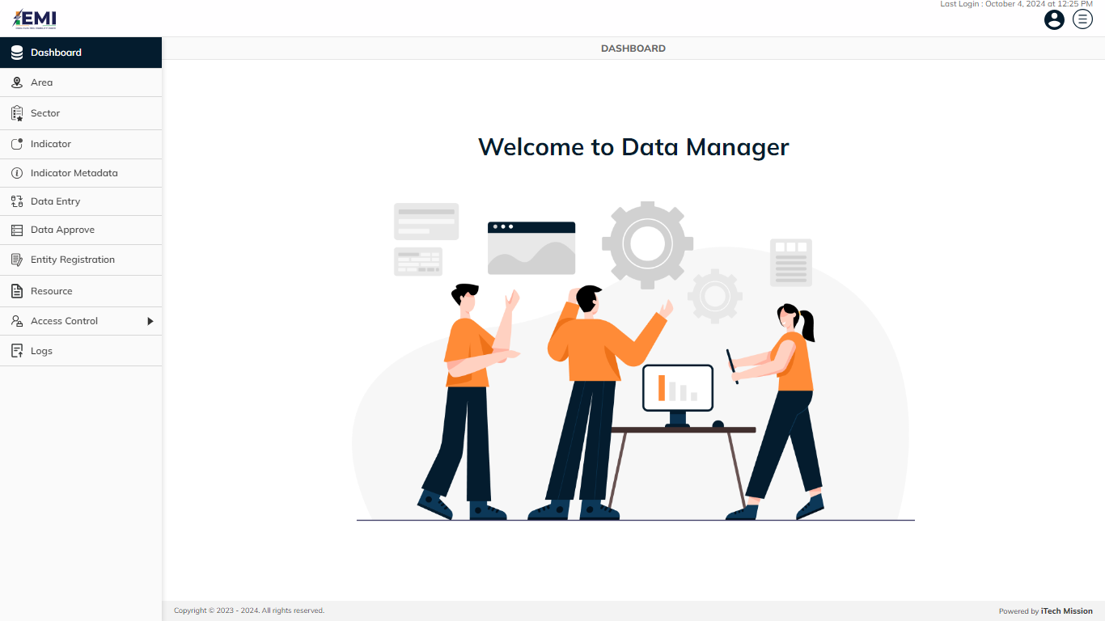
DASHBOARD
First page after the successful login into the data manager application

Slide 6
2
Area

Slide 7
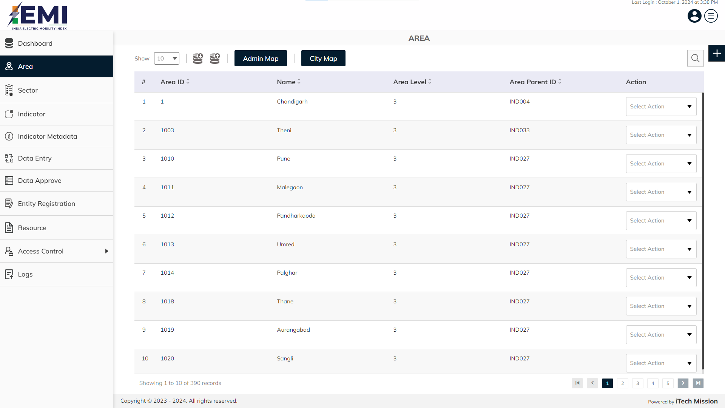
AREA
View and search areas from the available list . Click on plus button to add new area.

Slide 8
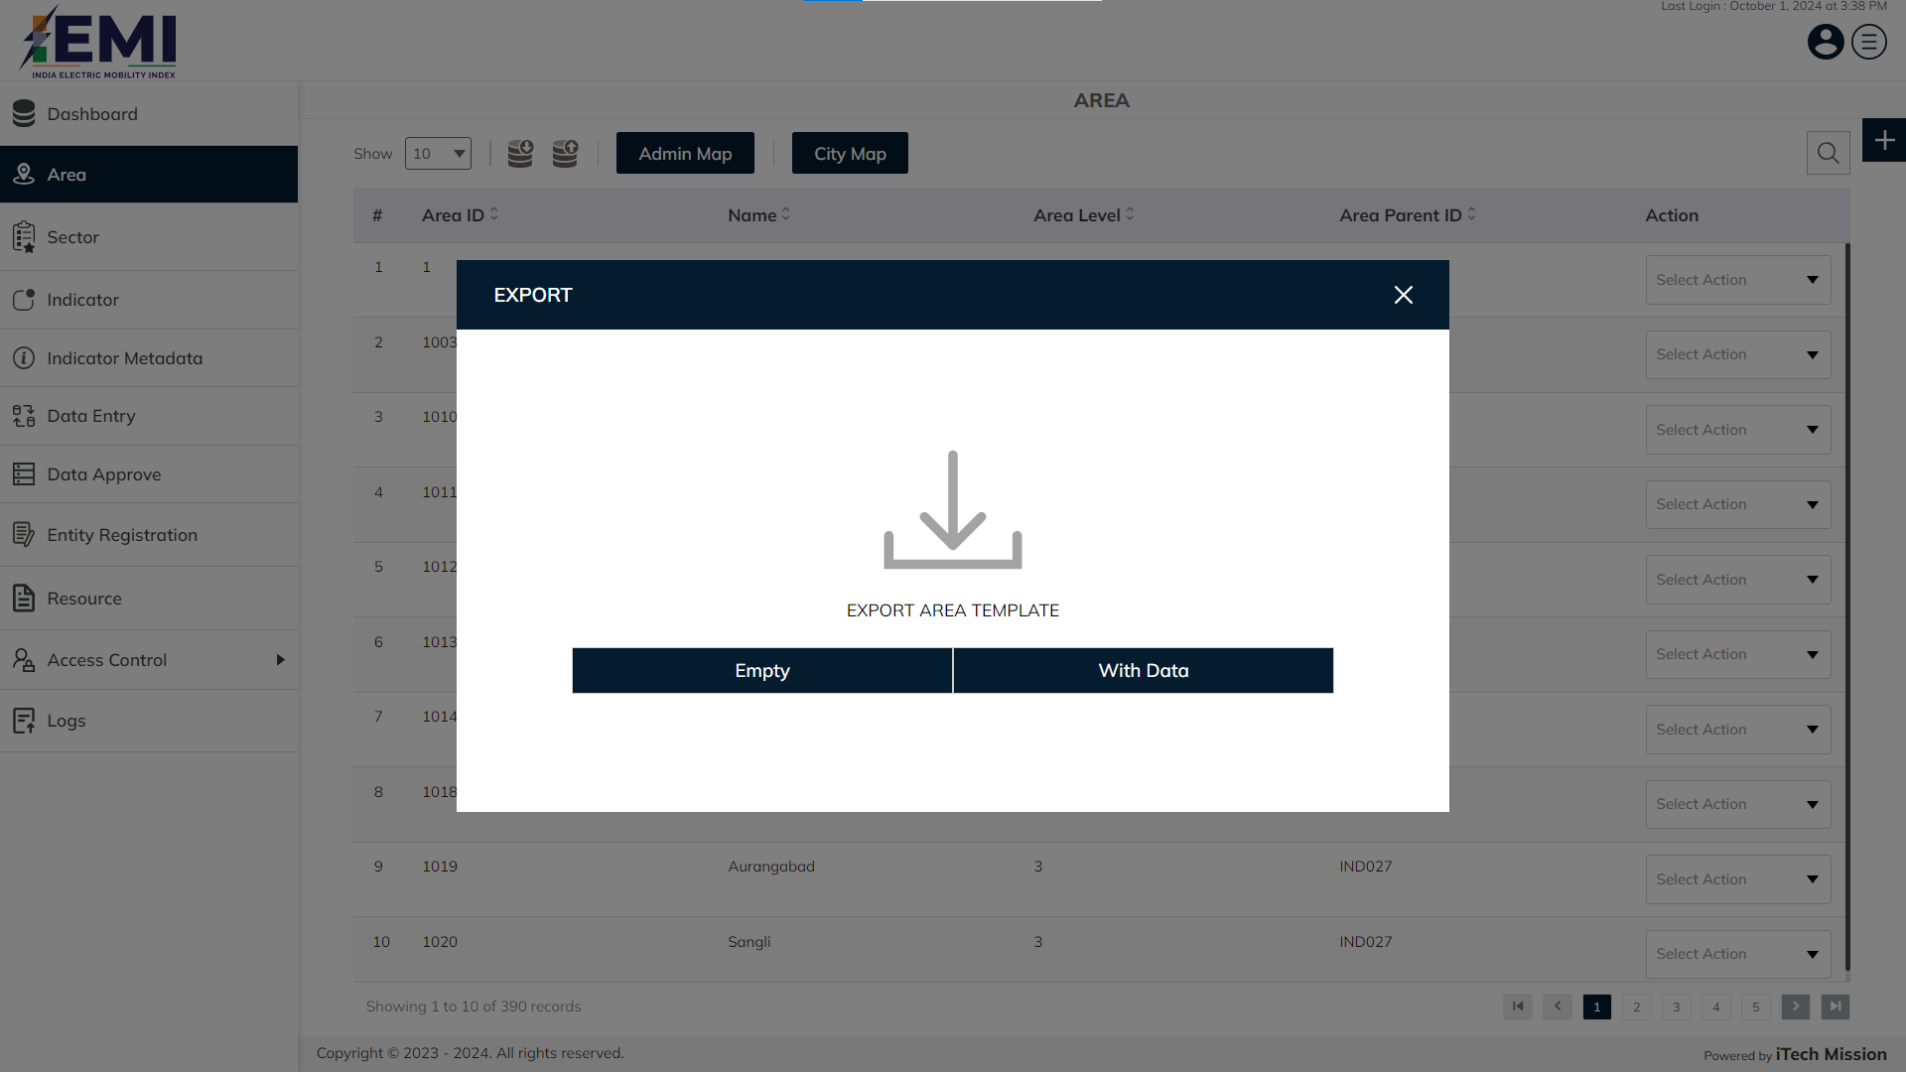
AREA
Export empty template/with data of area.

Slide 9
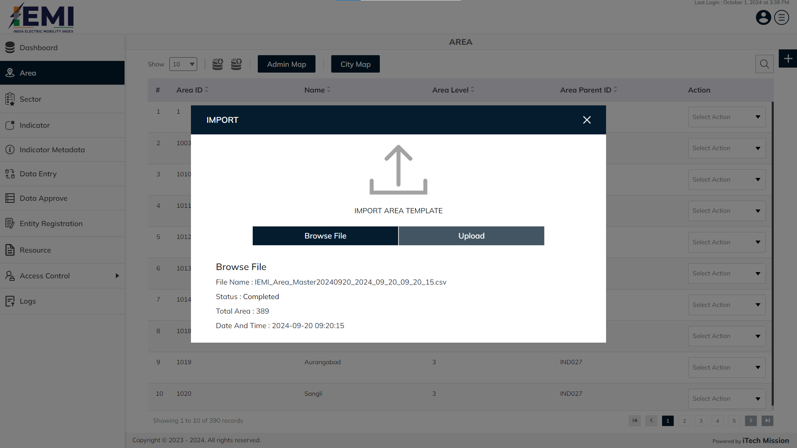
AREA
Click on Browse file button , select and import area file.

Slide 10

AREA
Click on Browse file button , select and import admin map file.

Slide 11

AREA
Click on Browse file button , select and import city map file.

Slide 12
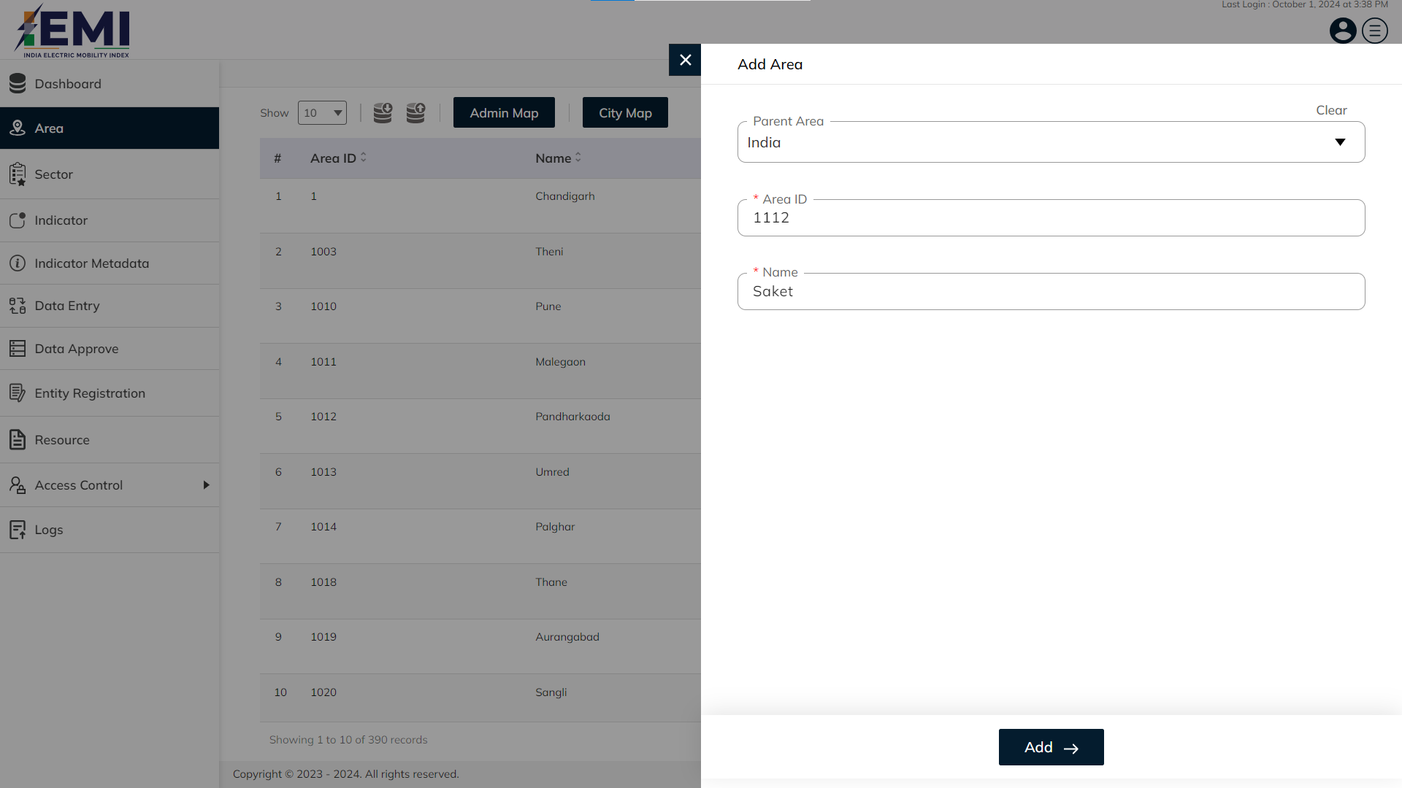
AREA
Enter mandatory details Parent Area , Area ID and Name. Click on the add button to confirm & save.

Slide 13
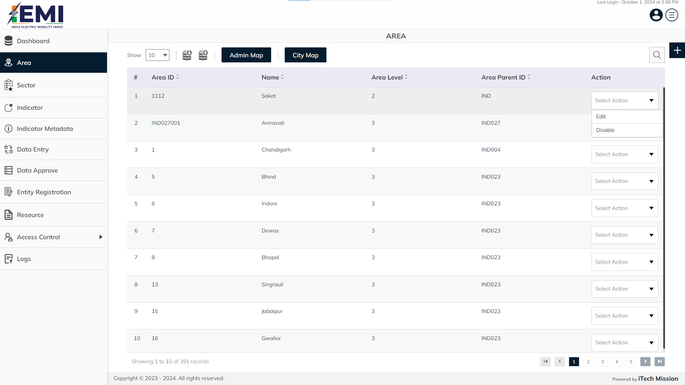
AREA
Click on the dropdown available under action column to edit and disable the area.

Slide 14
3
Sector

Slide 15
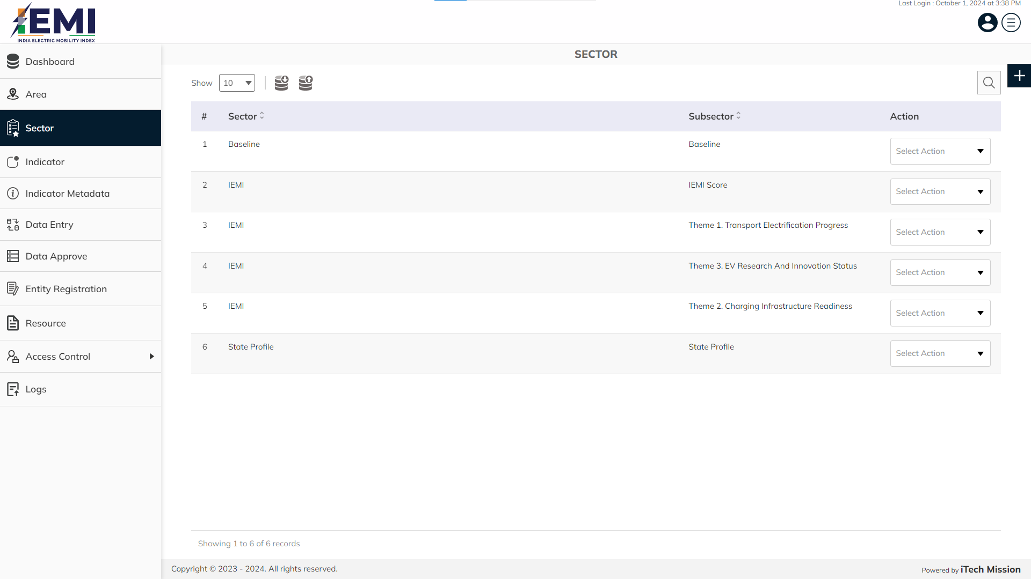
SECTOR
View and search existing sector from list. Click on plus button to add new sector.

Slide 16
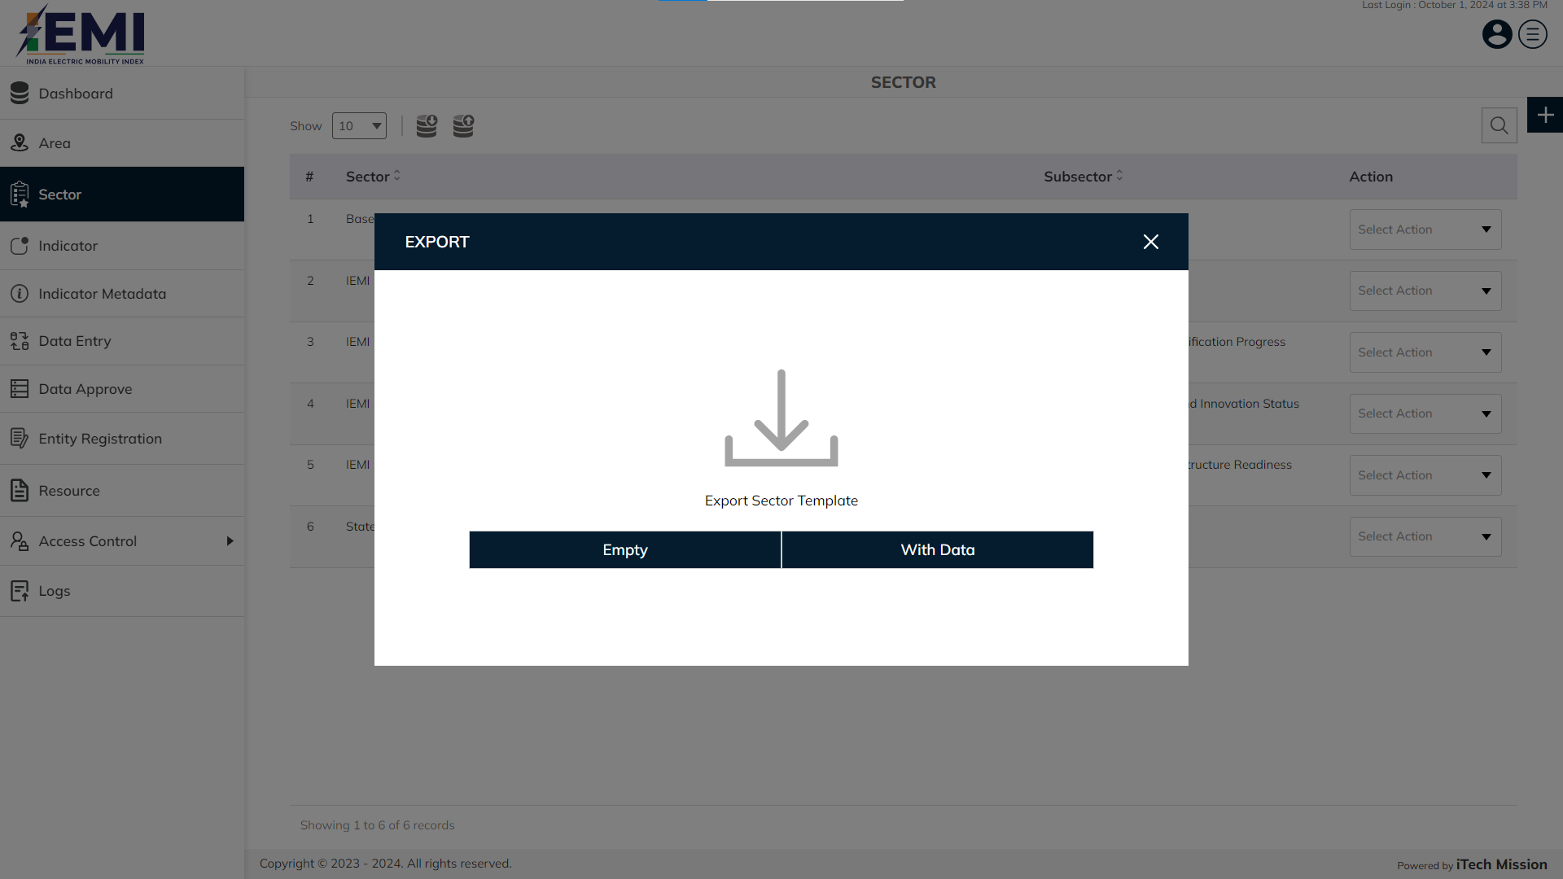
SECTOR
Export empty template/with data of sector.

Slide 17
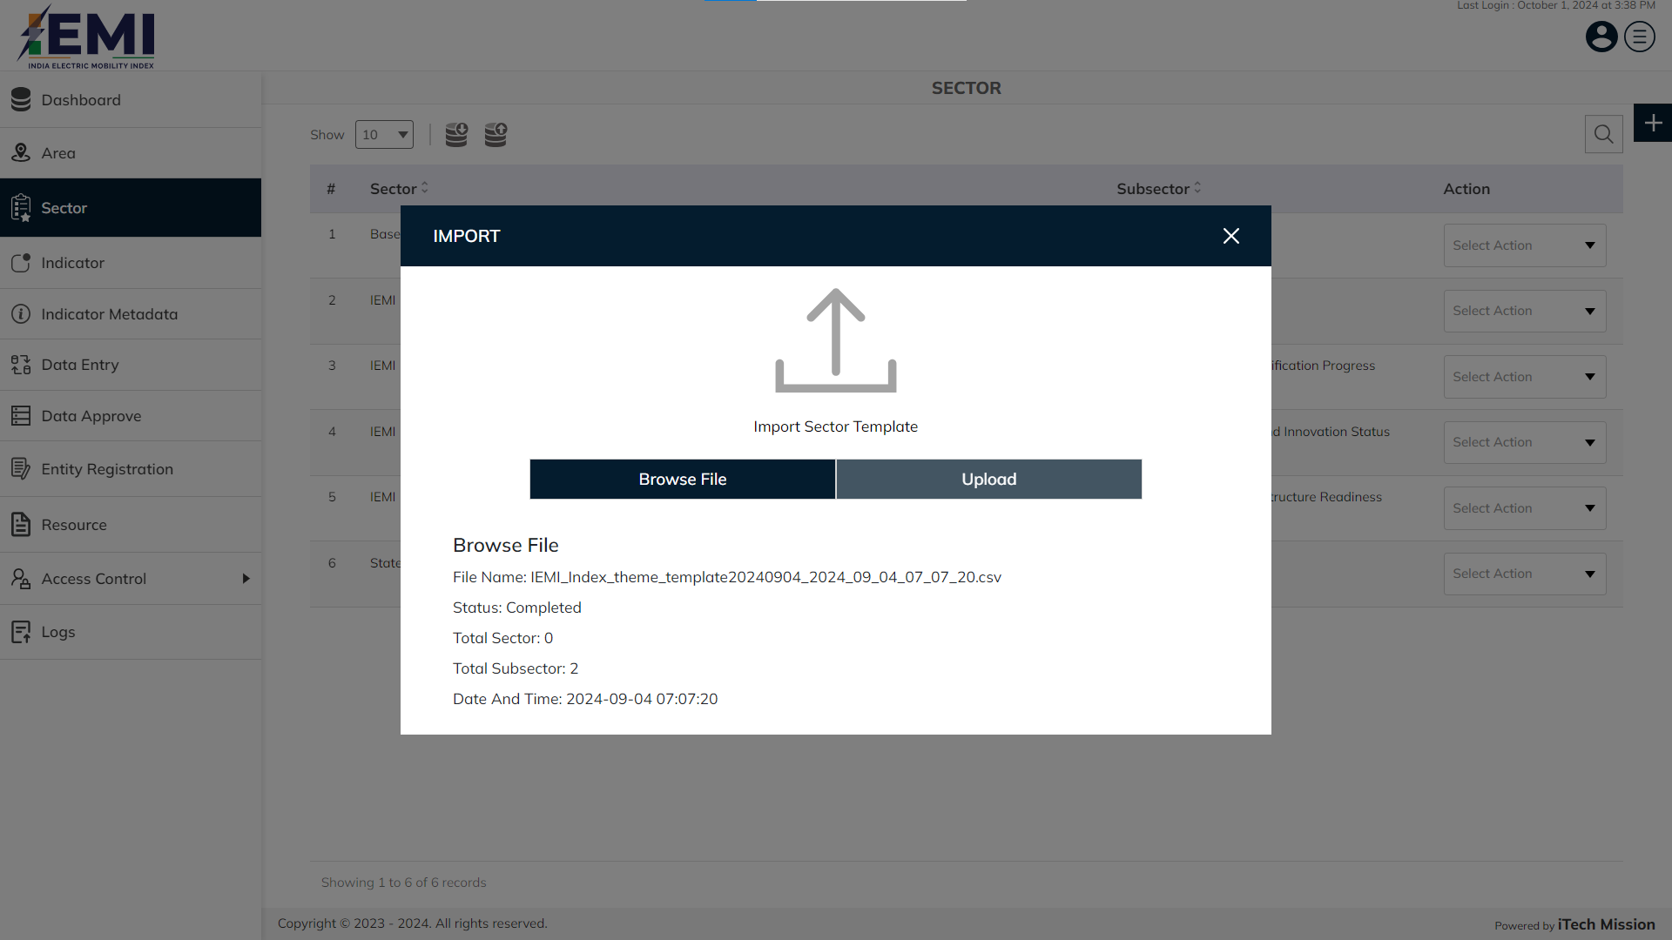
SECTOR
Click on Browse file button , select and import sector file.

Slide 18
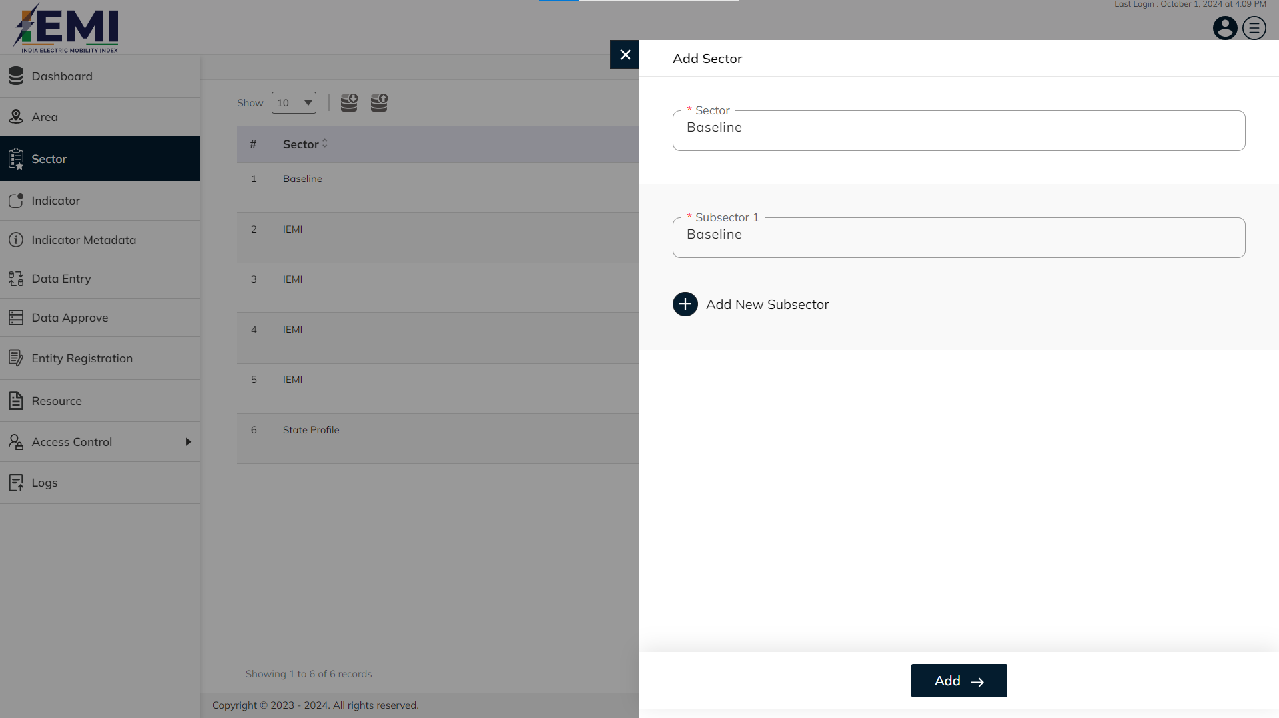
SECTOR
Enter mandatory details and Click on the add button to save & confirm

Slide 19

SECTOR
Click on the dropdown available under action column to edit and enable/disable the record

Slide 20
4
Indicator

Slide 21
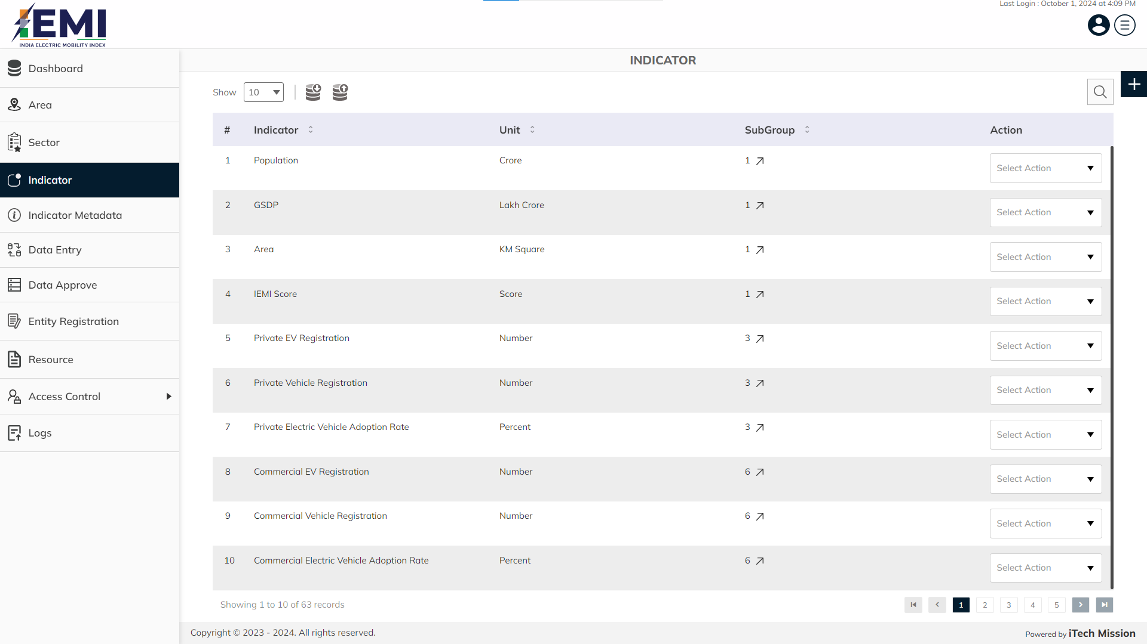
INDICATOR
View and search existing indicator from list. Click on plus button to add new indicator.

Slide 22
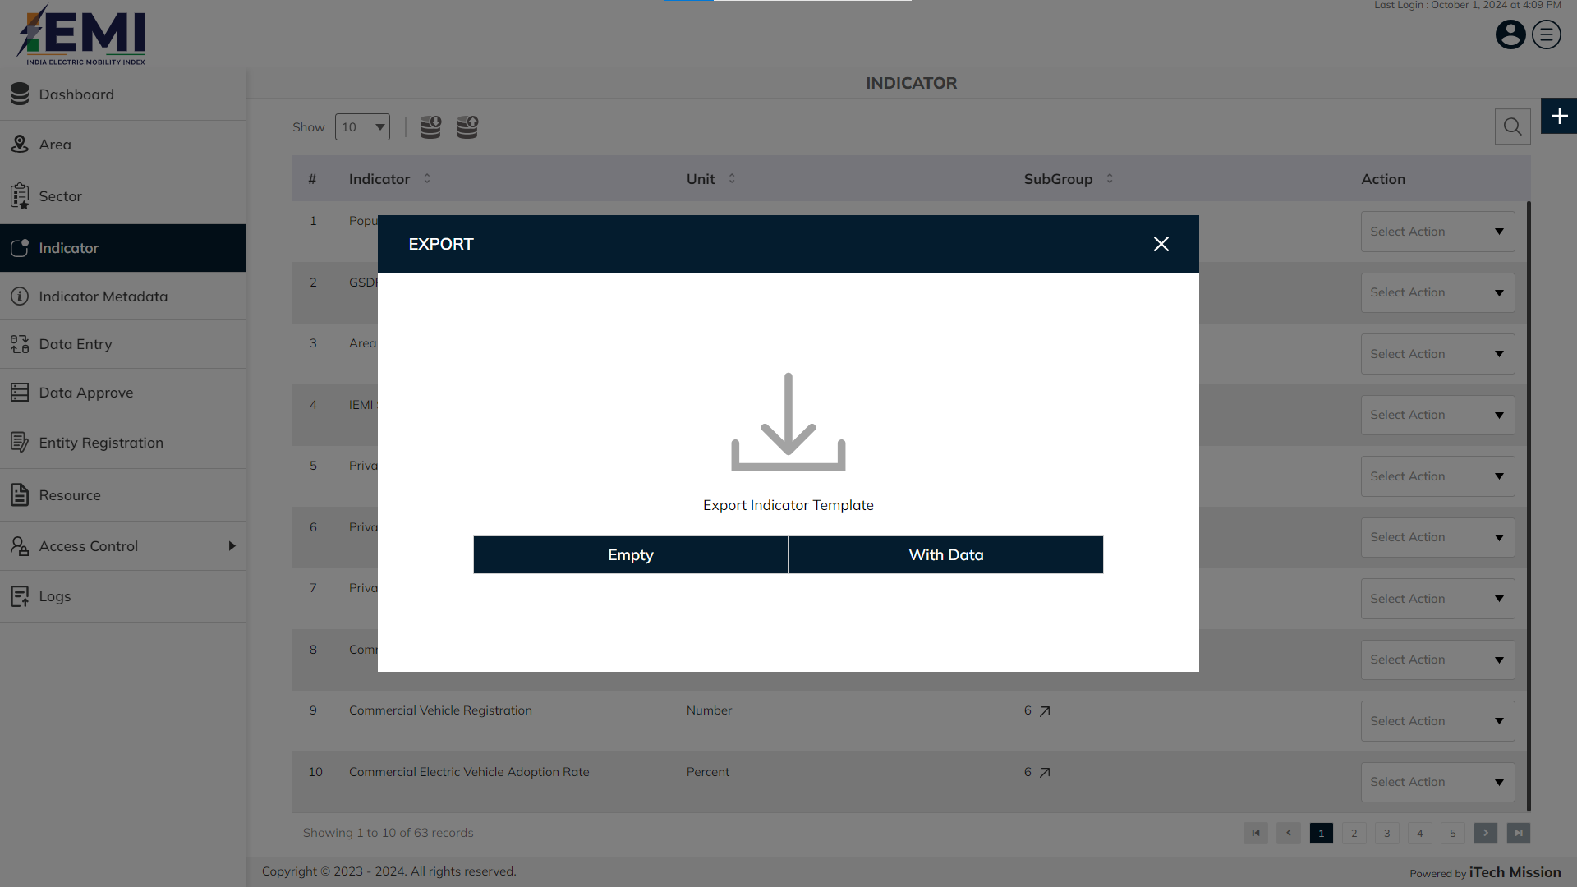
INDICATOR
Export empty template/with data of indicator.

Slide 23
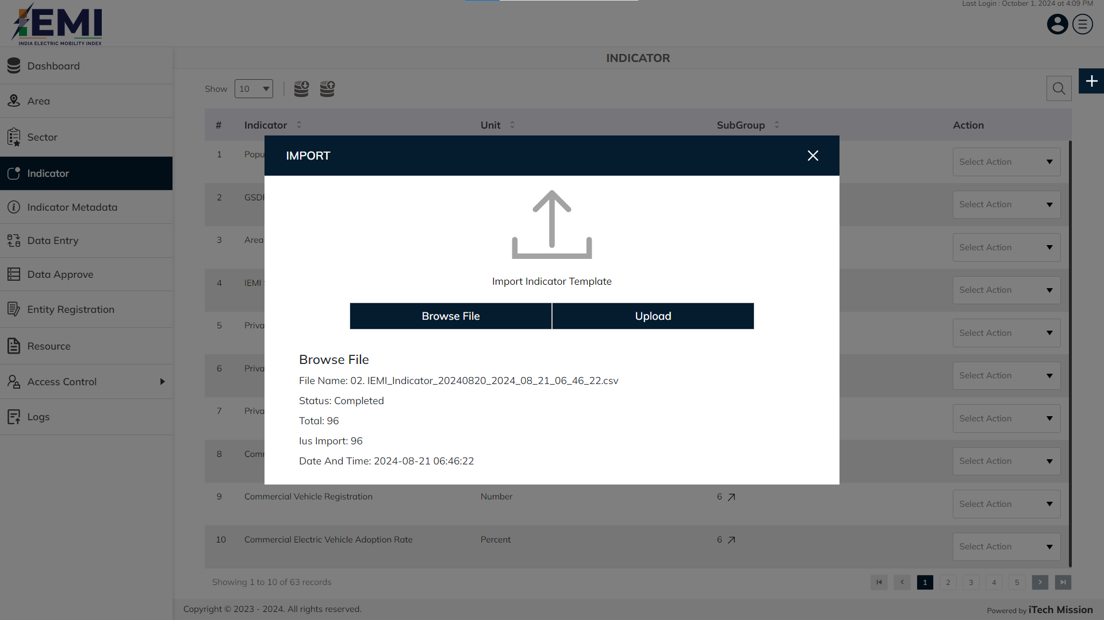
INDICATOR
Click on Browse file option to browse and select the required file. Click on the Upload option to start the import process

Slide 24
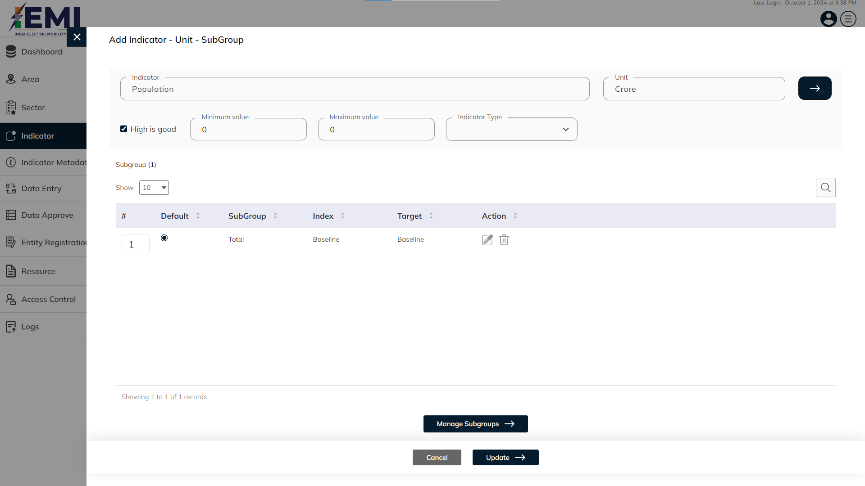
INDICATOR
Enter indicator and unit. Click on the manage subgroup button to add subgroup.

Slide 25
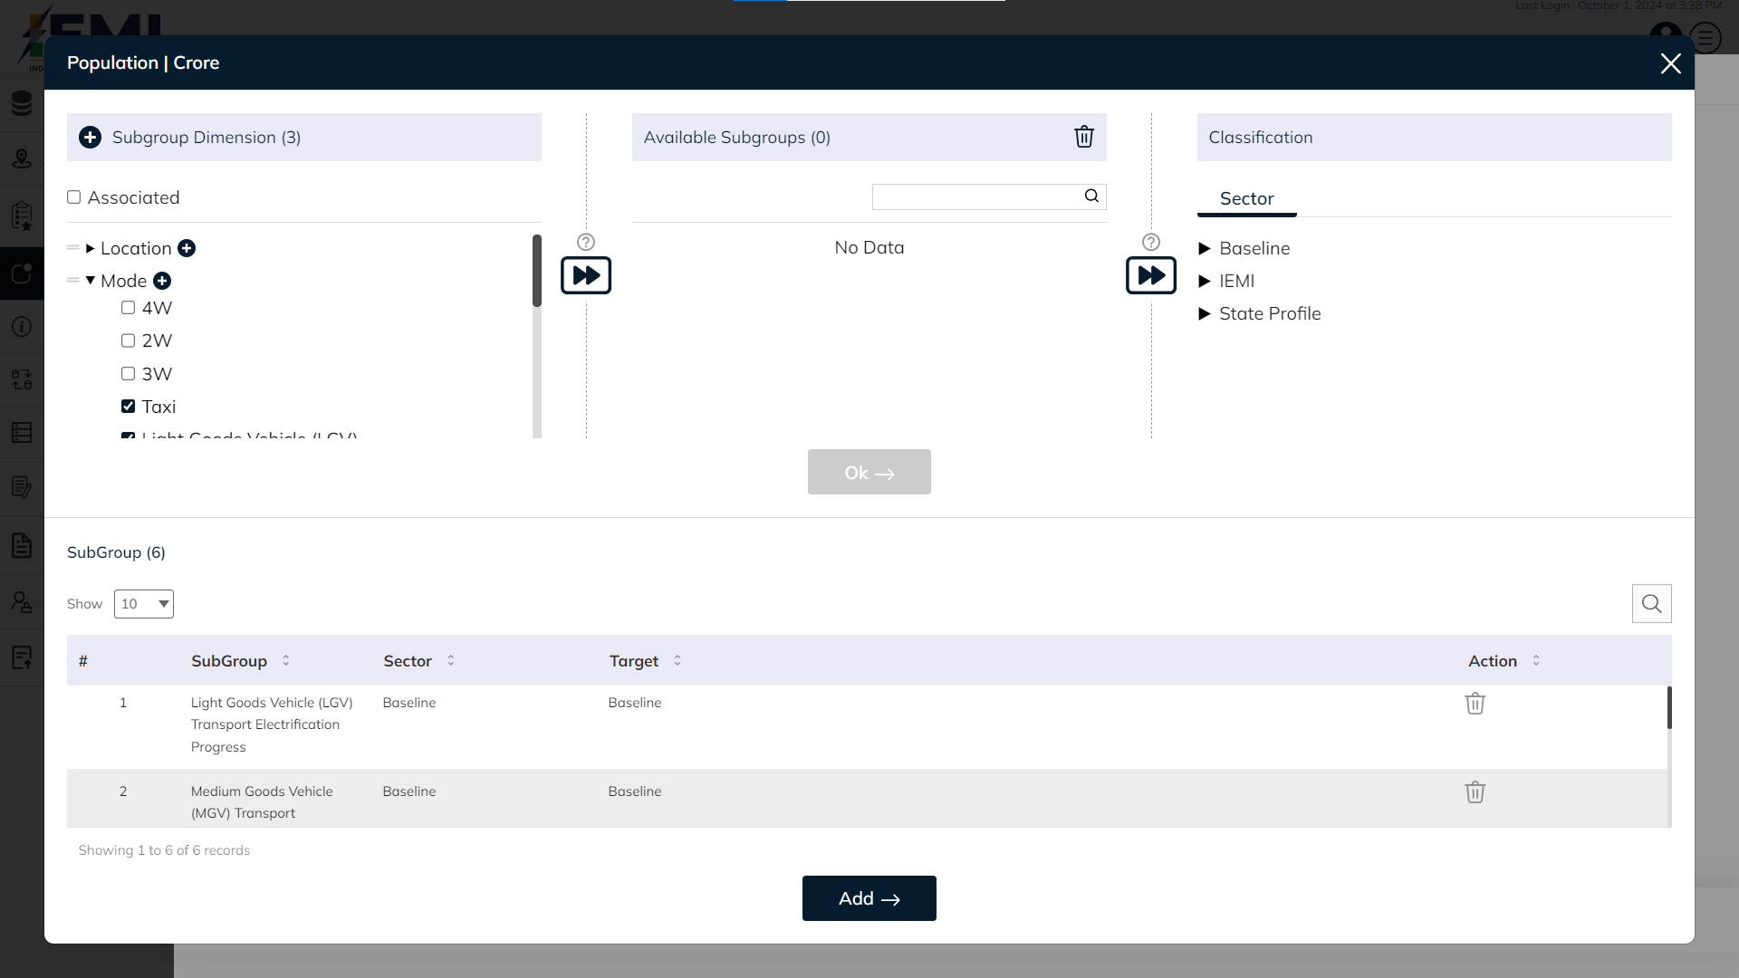
INDICATOR
Select location, mode and type from subgroup dimension. Click on OK button to confirm and click on ADD button to save.

Slide 26
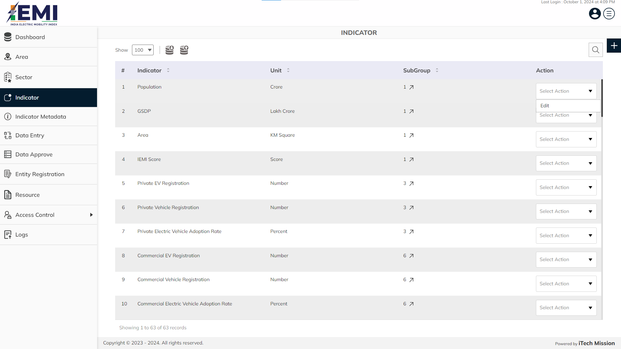
INDICATOR
Click on the dropdown available under action column to edit the indicator.

Slide 27
5
Indicator Metadata

Slide 28
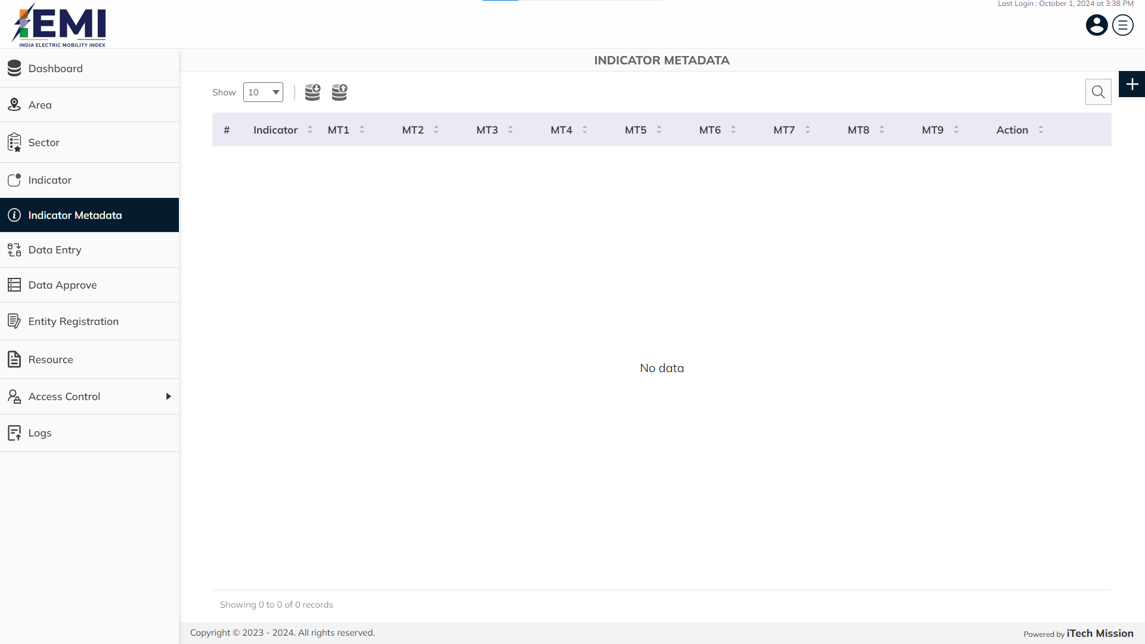
INDICATOR METADATA
View and search existing indicator metadata from list. Click on plus button to add new indicator metadata.

Slide 29
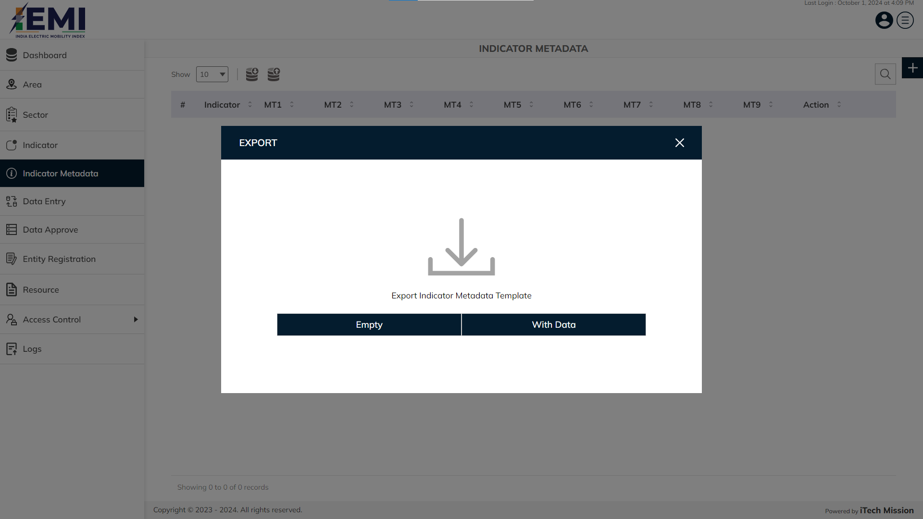
INDICATOR METADATA
Export empty template/with data of indicator metadata.

Slide 30
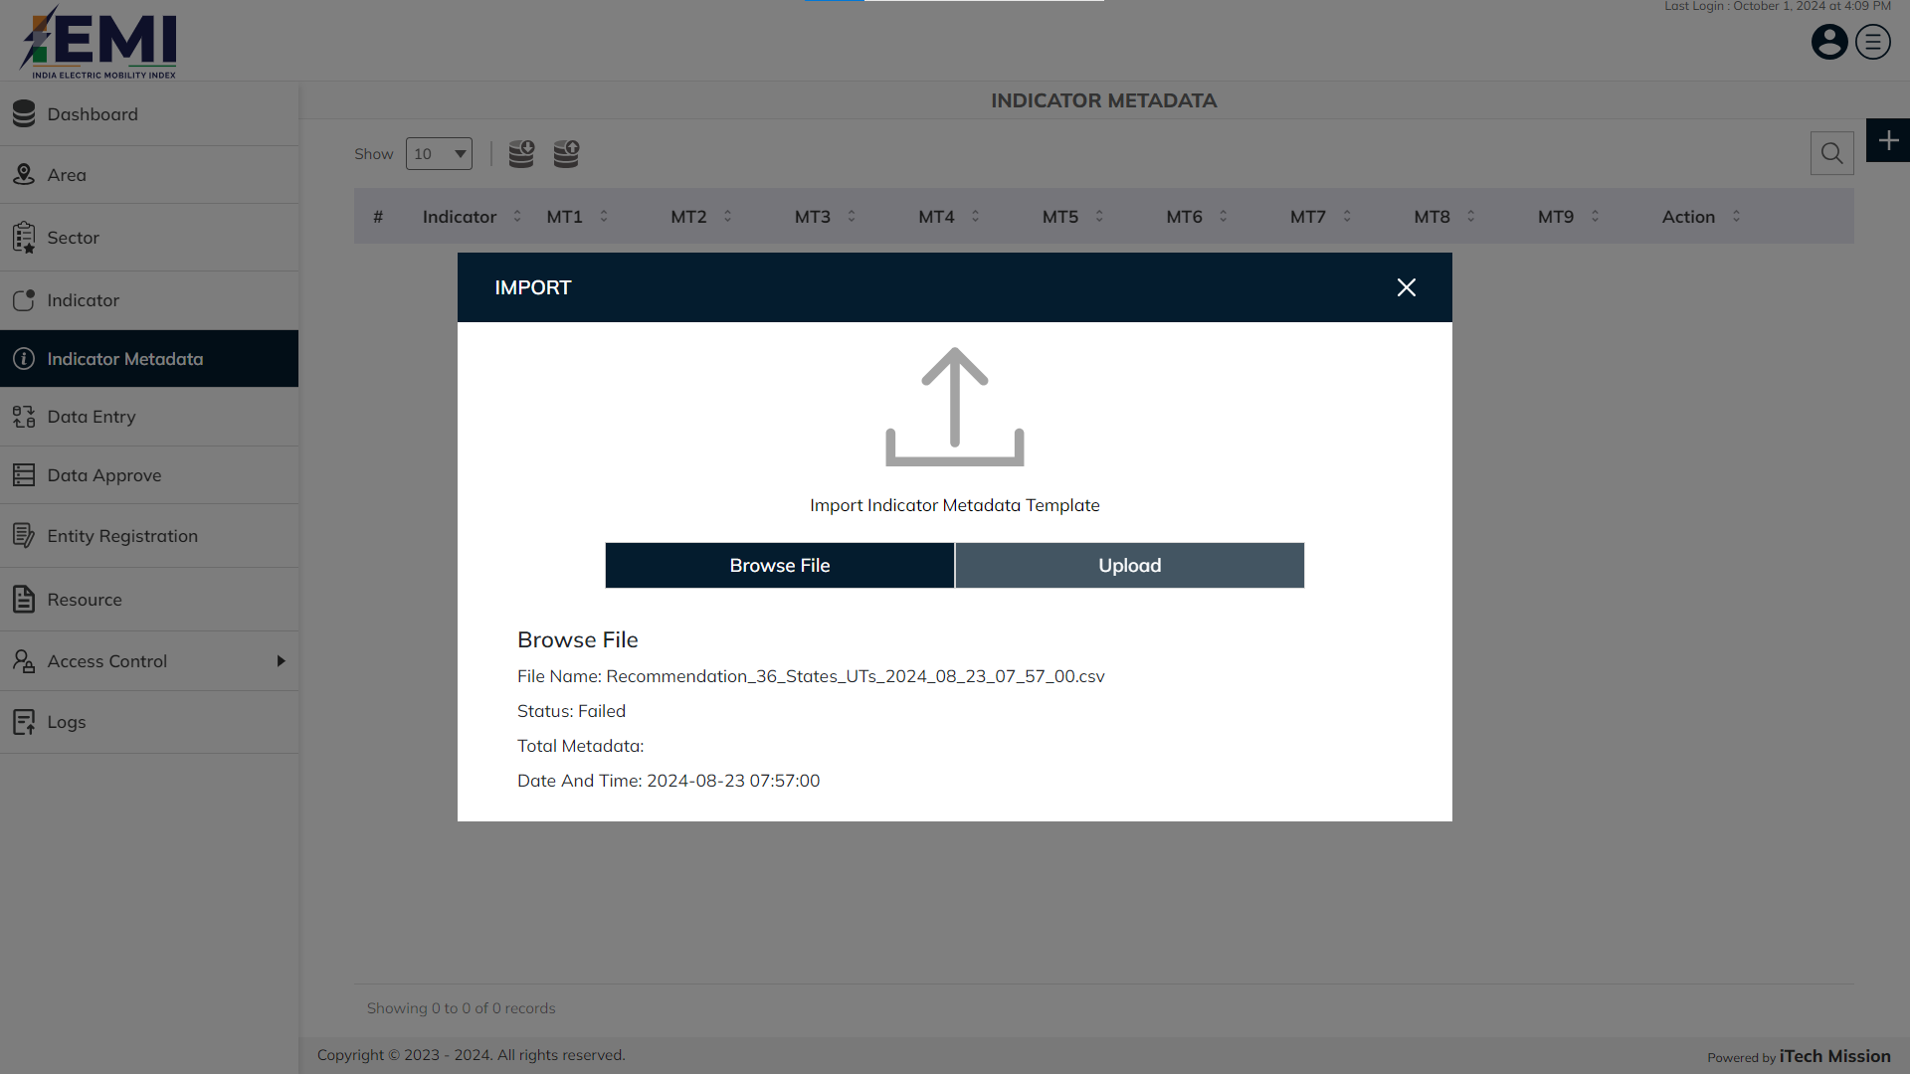
INDICATOR METADATA
Click on Browse file option to browse and select the required file. Click on the Upload option to start the import process

Slide 31
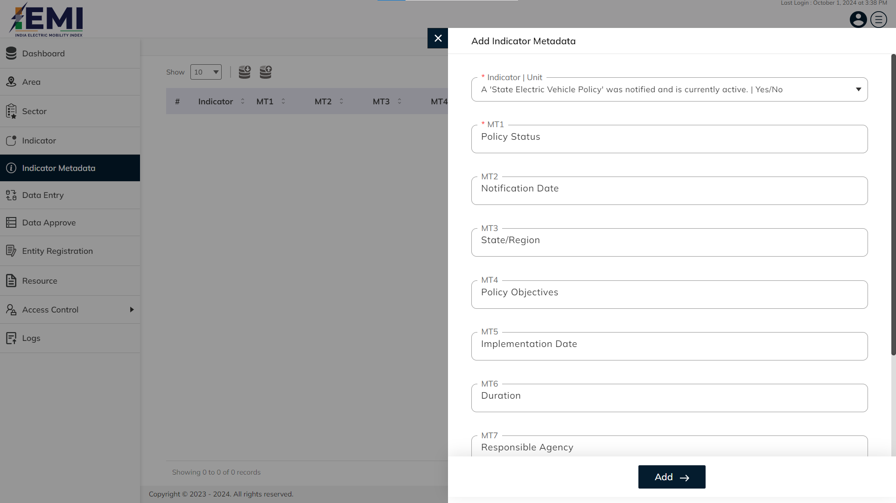
INDICATOR METADATA
Enter mandatory details like indicator | unit and MT1. Click on add button to confirm and save.

Slide 32

INDICATOR METADATA
Click on the dropdown available under action column to edit and delete the indicator metadata.

Slide 33
6
DATA ENTRY

Slide 34
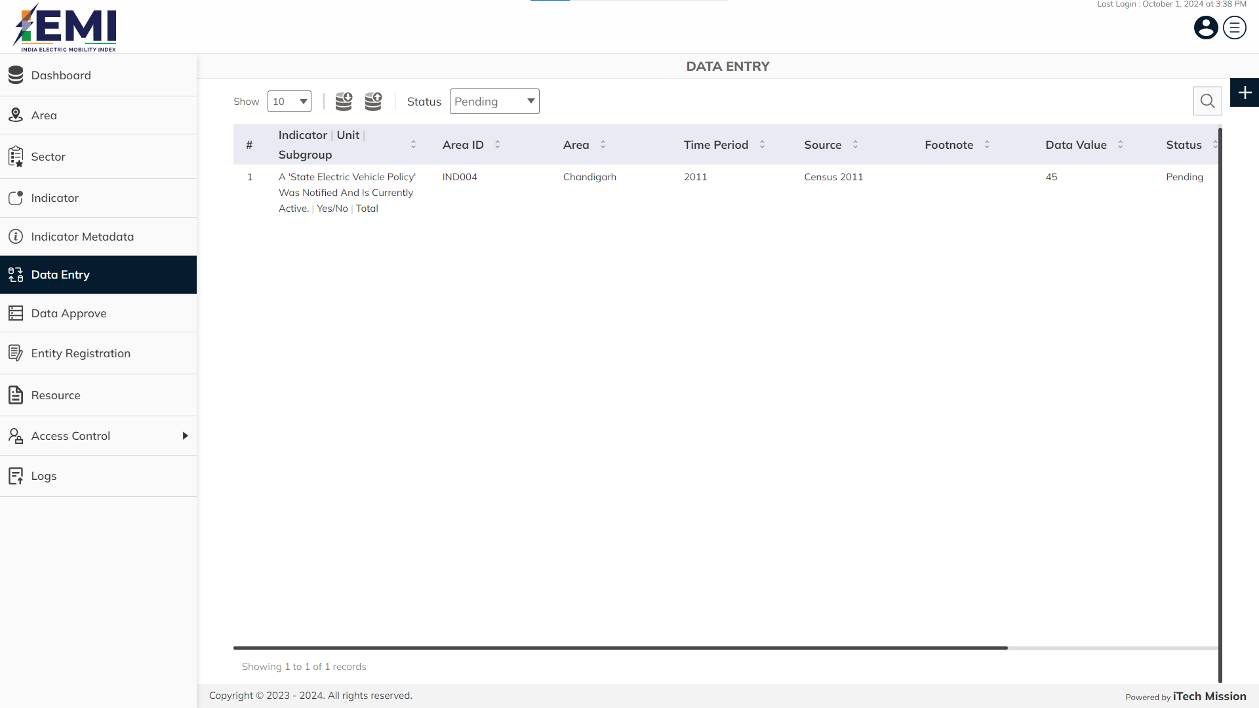
DATA ENTRY
View and search existing data entry from list. Click on plus button to add new data entry.

Slide 35
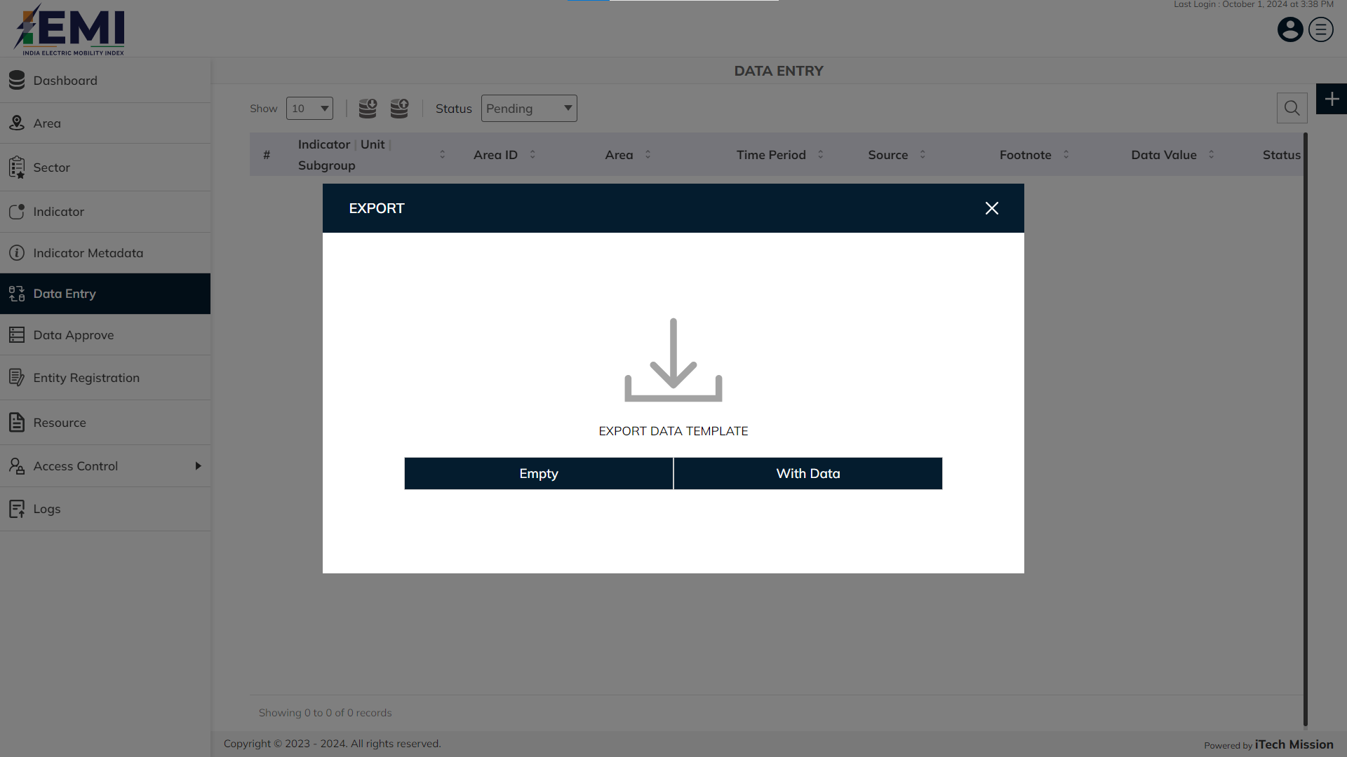
DATA ENTRY
Export empty template/with data of data entry.

Slide 36
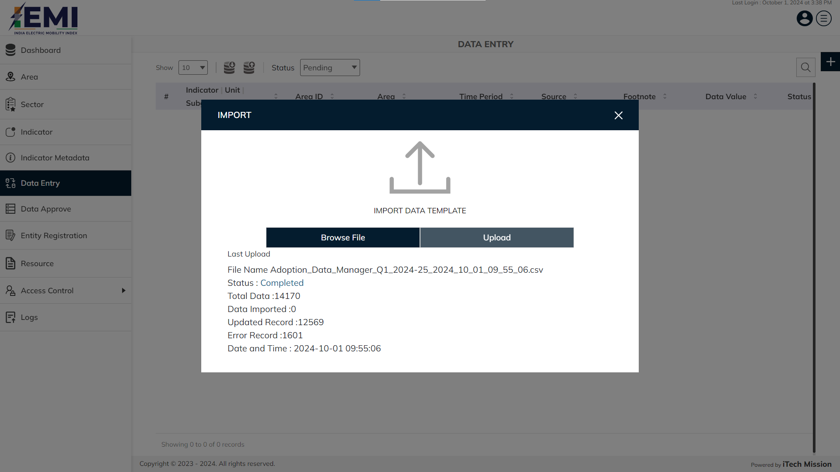
DATA ENTRY
Click on Browse file button , select and import data entry file.

Slide 37
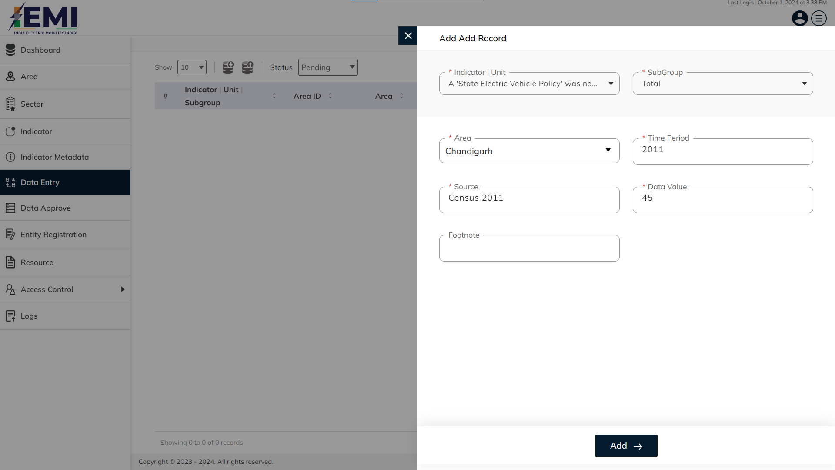
DATA ENTRY
Enter mandatory details like indicator | unit, subgroup, area, time period, source and data value . Click on add button to confirm and save.

Slide 38
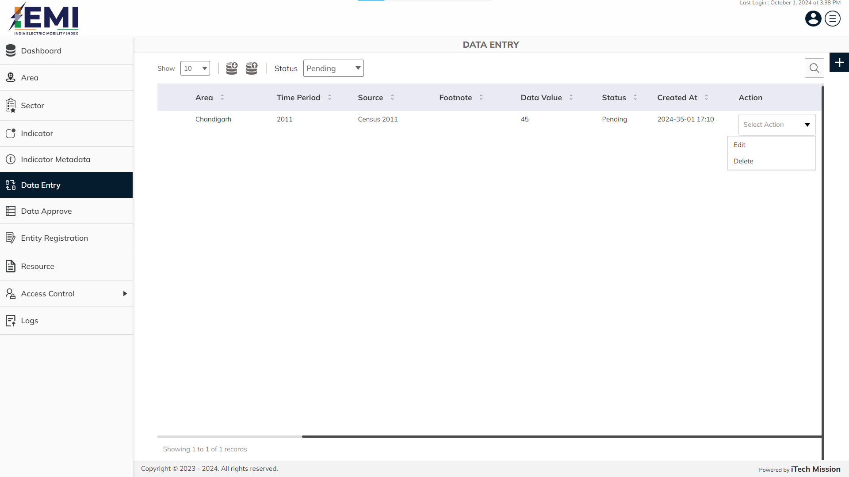
DATA ENTRY
Click on the dropdown available under action column to edit and delete the data entry.

Slide 39
7
DATA APPROVE

Slide 40
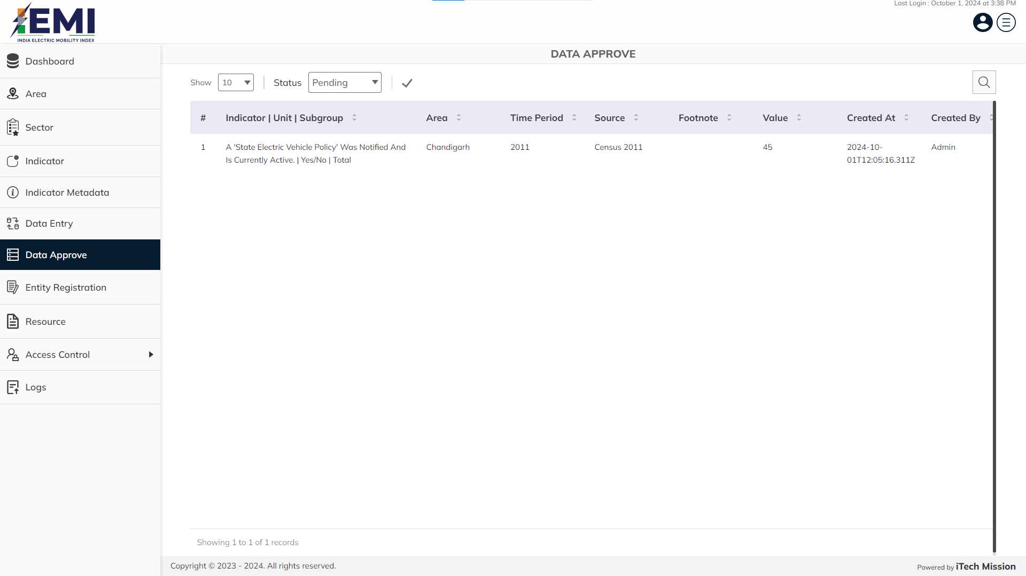
DATA APPROVE
View and search existing data approve from pending data list.

Slide 41
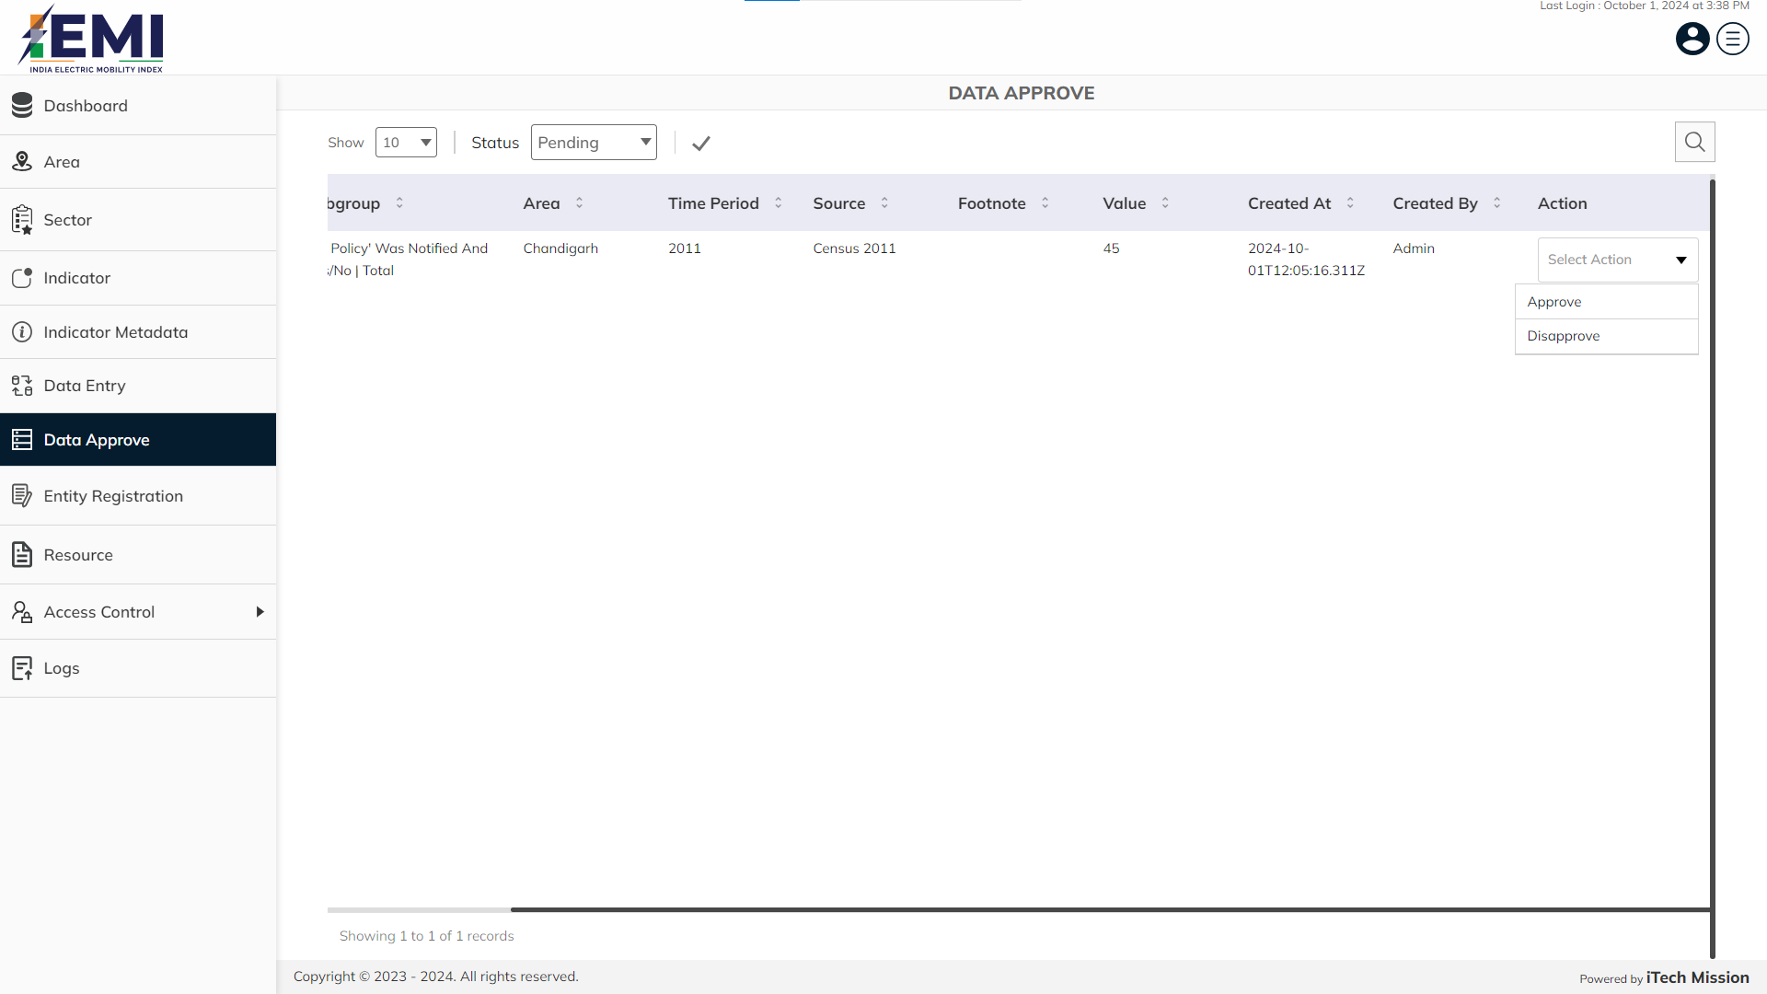
DATA APPROVE
Click on the dropdown available under action column to approve and disapprove the data entry .

Slide 42
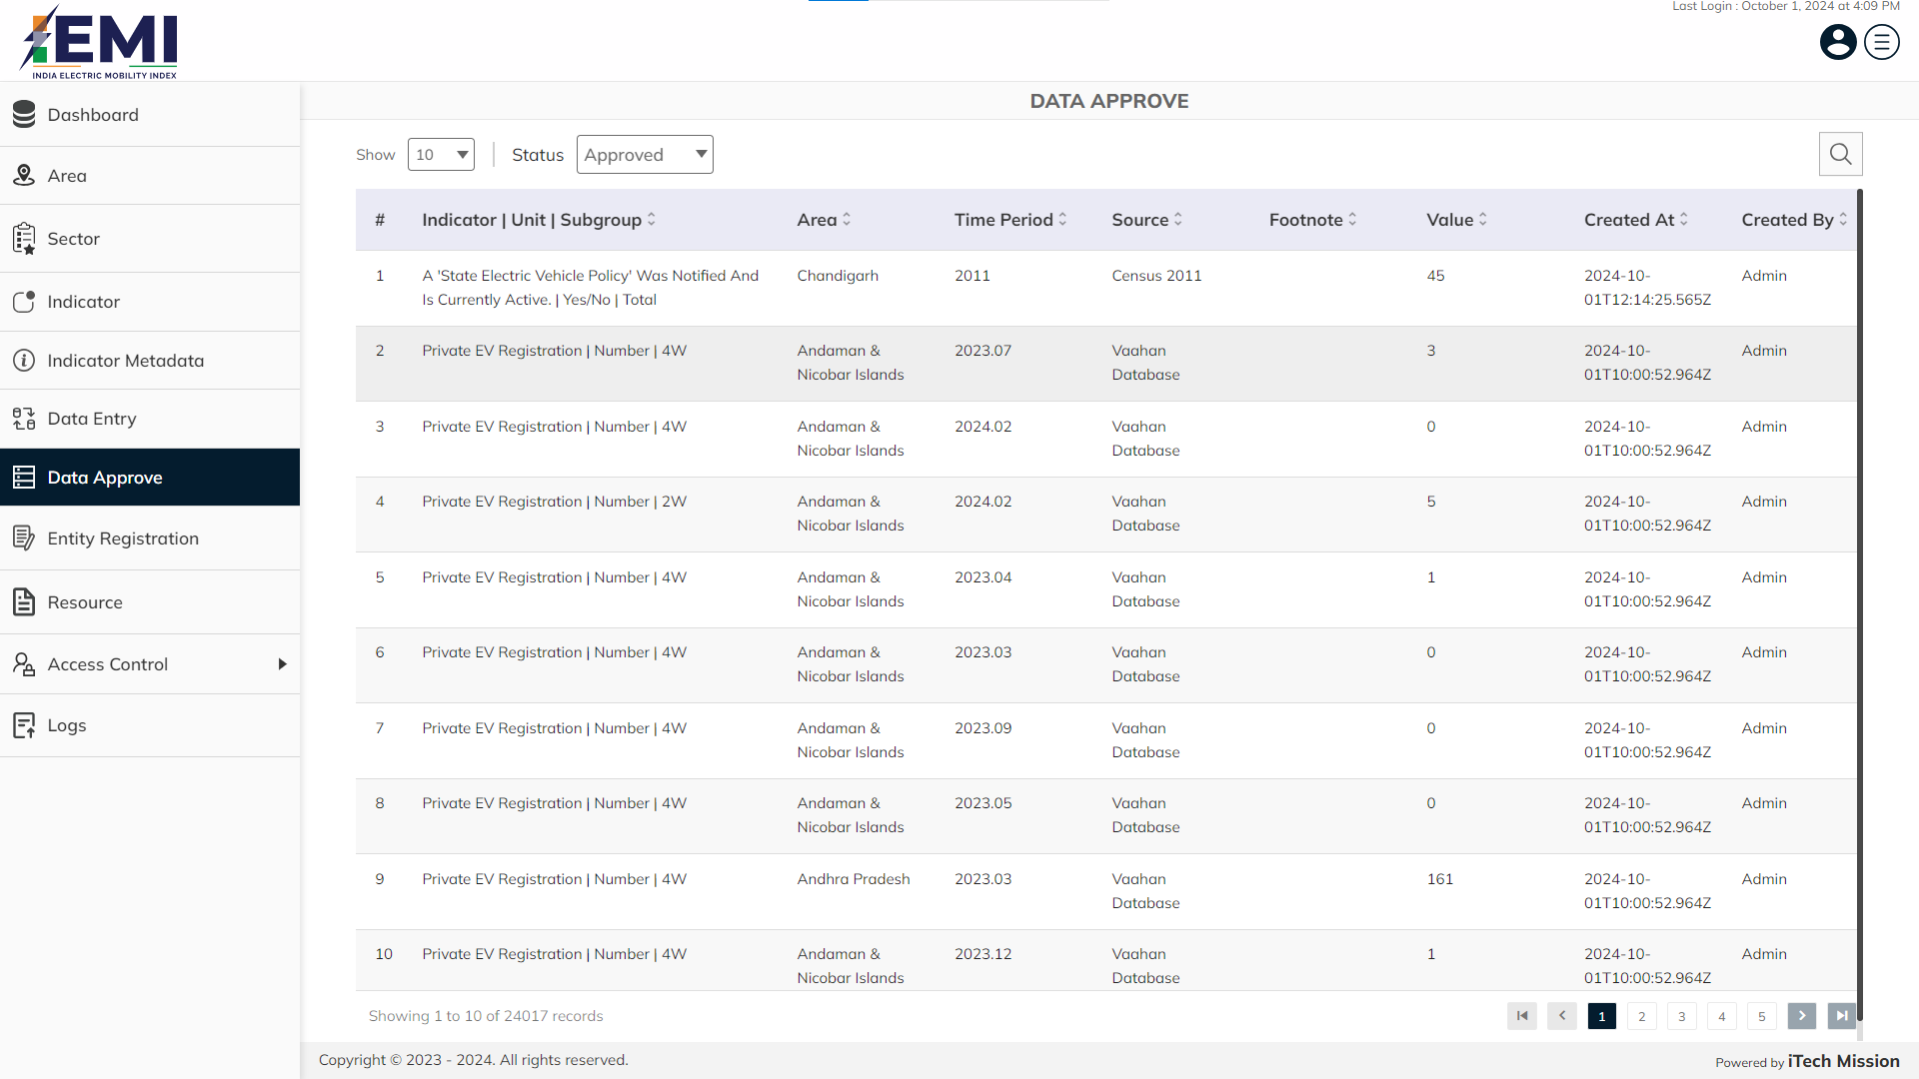
DATA APPROVE
View and search existing and newly approved data from list.

Slide 43
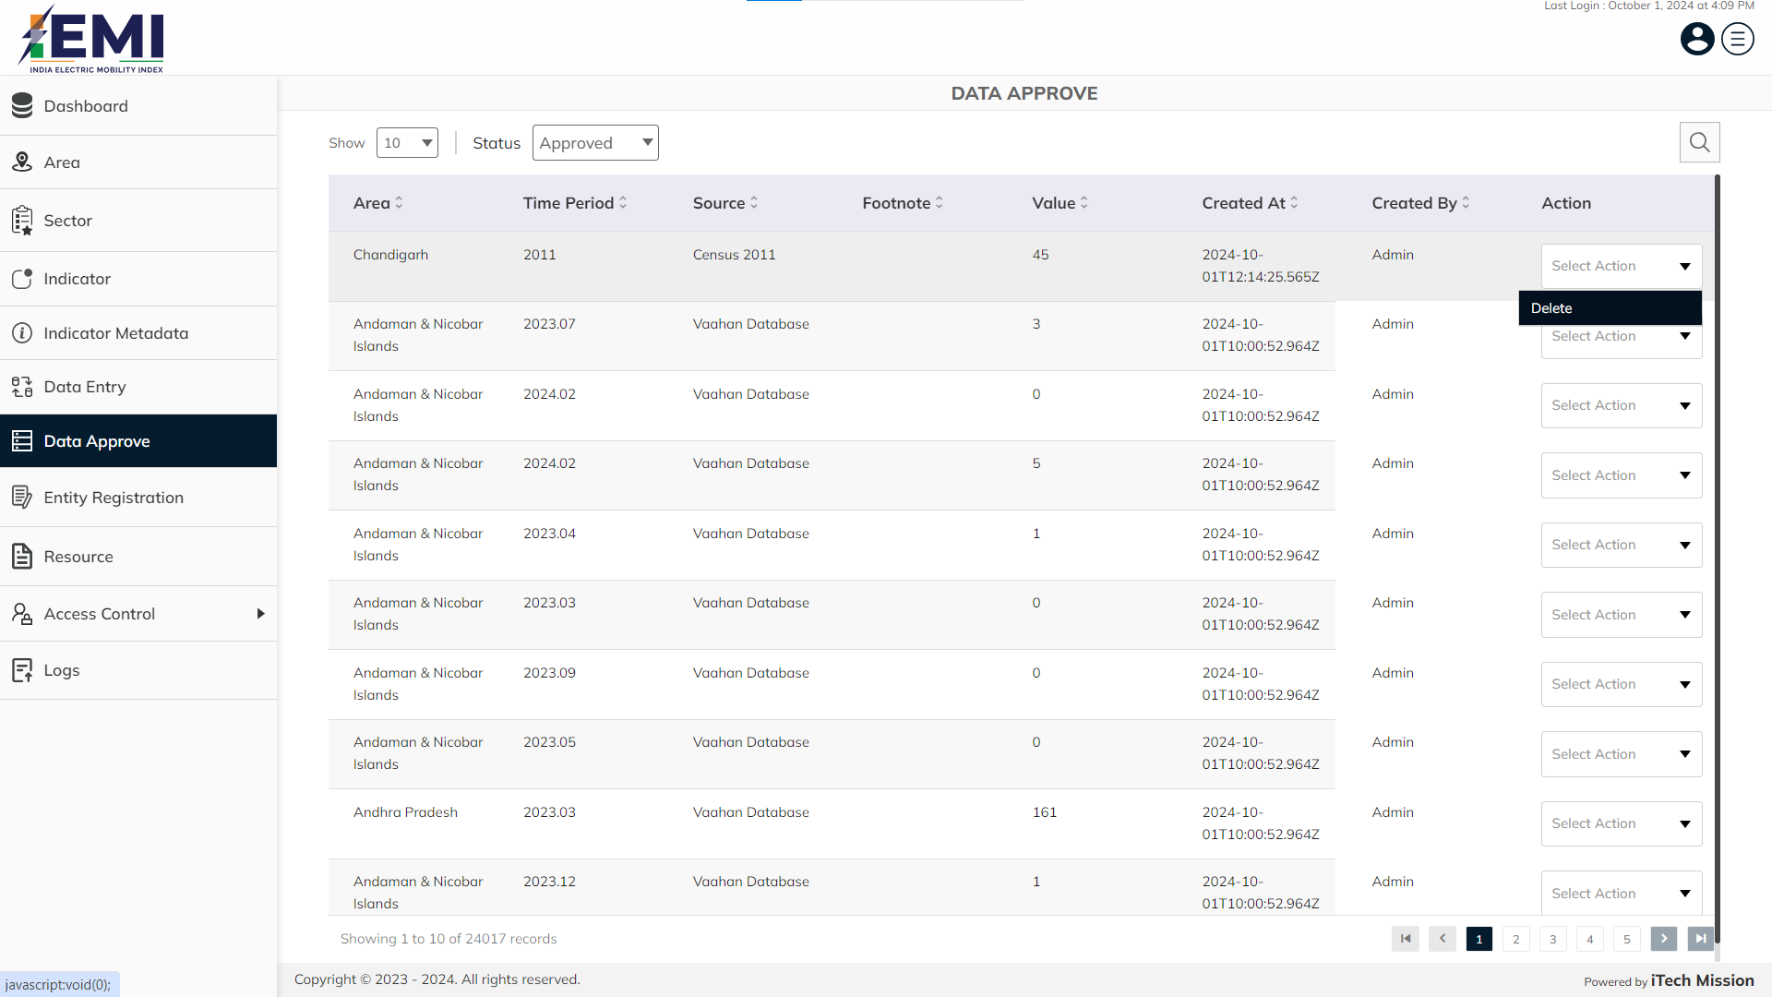
DATA APPROVE
Click on the dropdown available under action column to delete the approved data.

Slide 44
8
ENTITY REGISTRATION

Slide 45
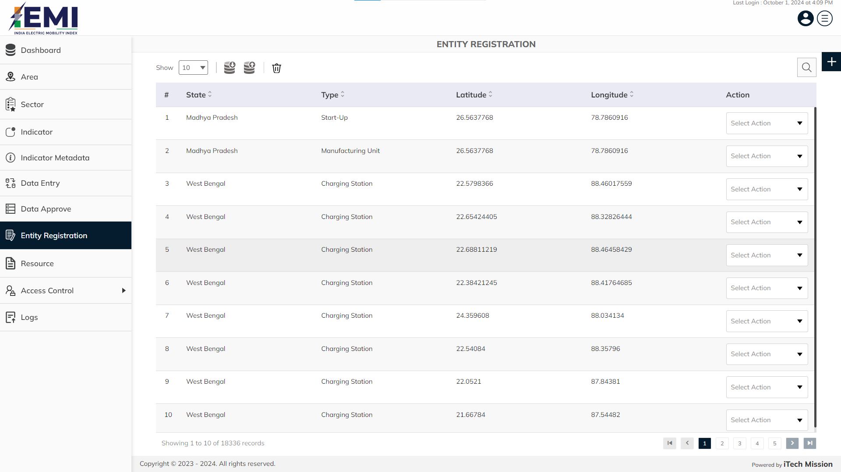
ENTITY REGISTRATION
View and search existing entity registration from list. Click on plus button to add new entity registration.

Slide 46
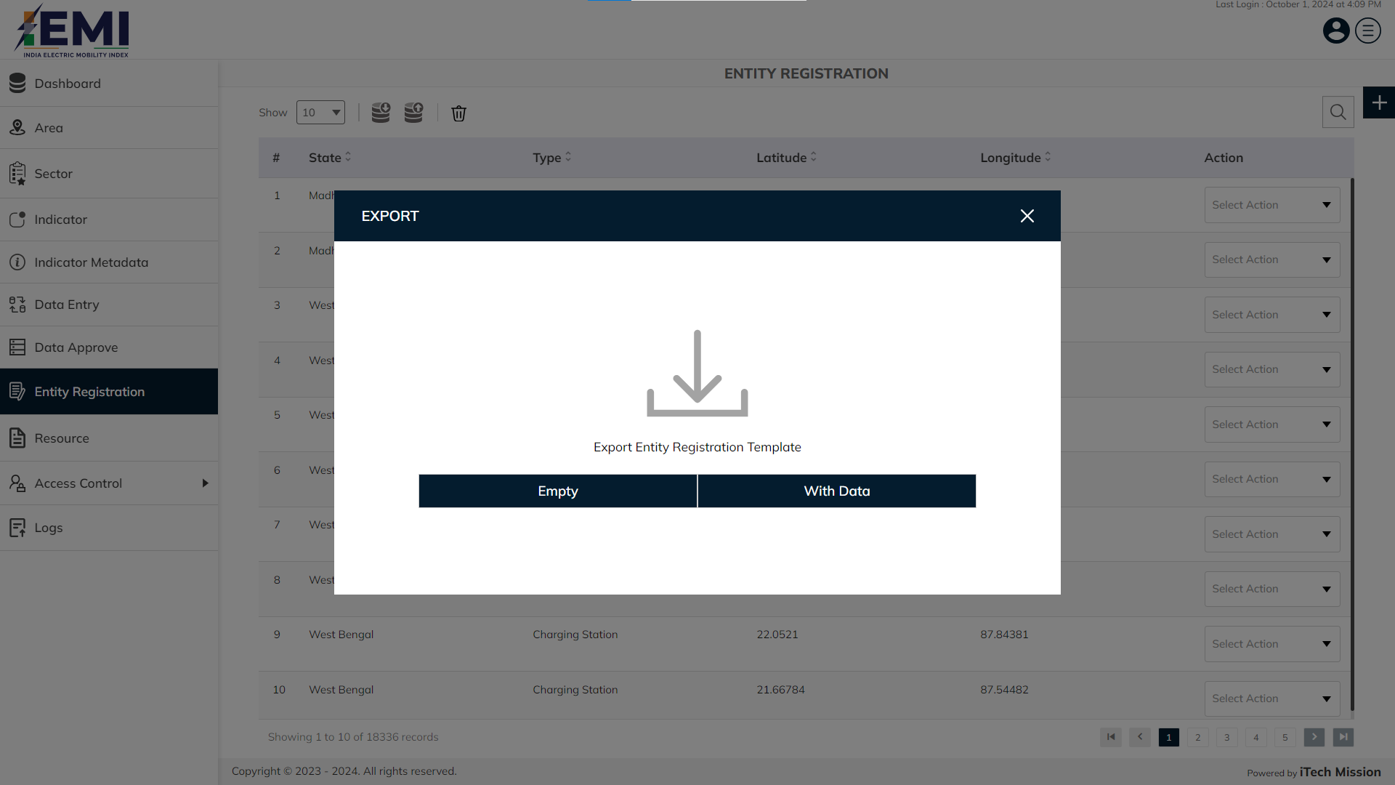
ENTITY REGISTRATION
Export empty template/with data of entity registration.

Slide 47
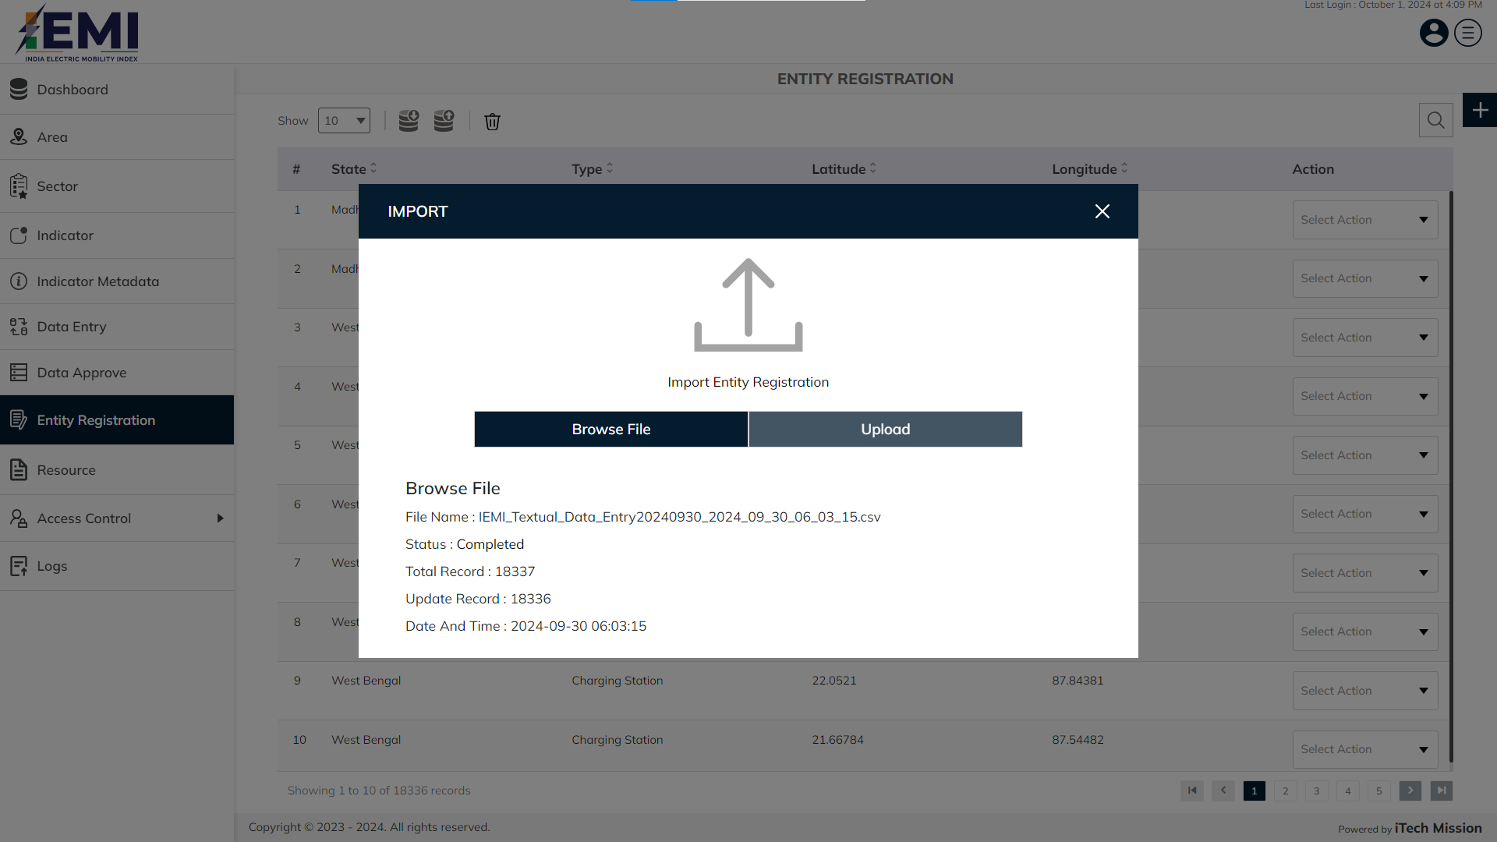
ENTITY REGISTRATION
Click on Browse file button , select and import entity registration file.

Slide 48
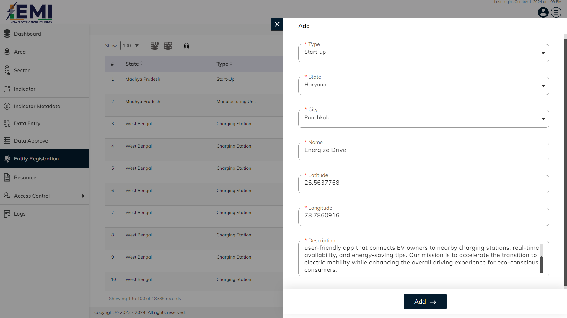
ENTITY REGISTRATION
Enter mandatory details like type, state, city, name, latitude, longitude, description. Click on add button to confirm and save.

Slide 49
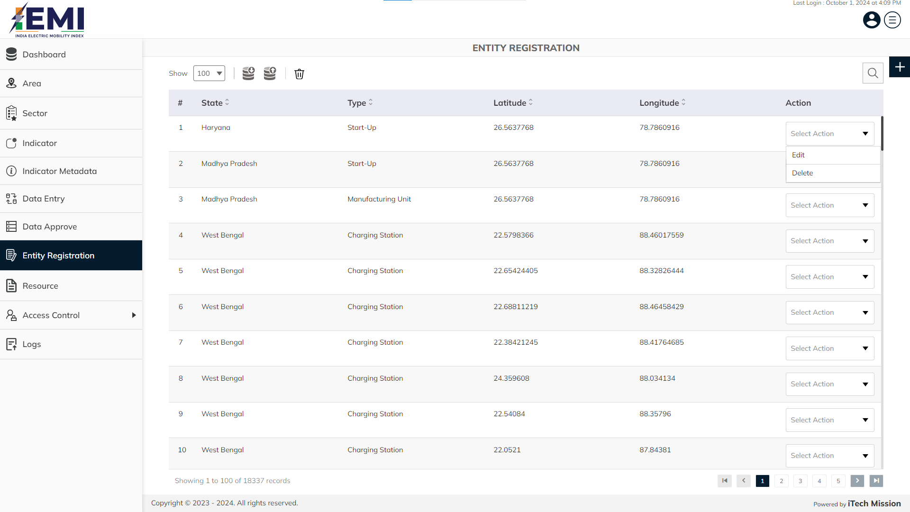
ENTITY REGISTRATION
Click on the dropdown available under action column to edit and delete the entity registration.

Slide 50
9
RESOURCE

Slide 51
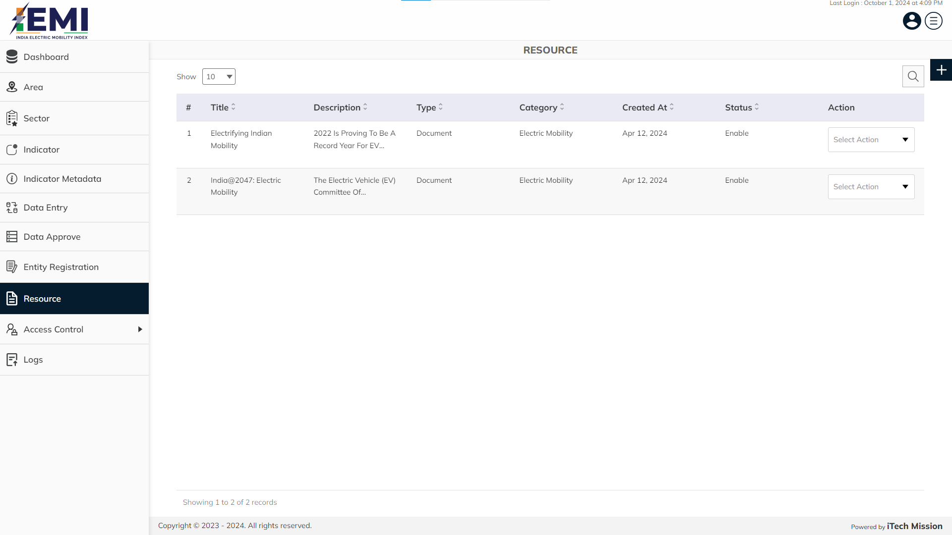
RESOURCE
View and search existing resource list. Click on plus button to add new resource.

Slide 52
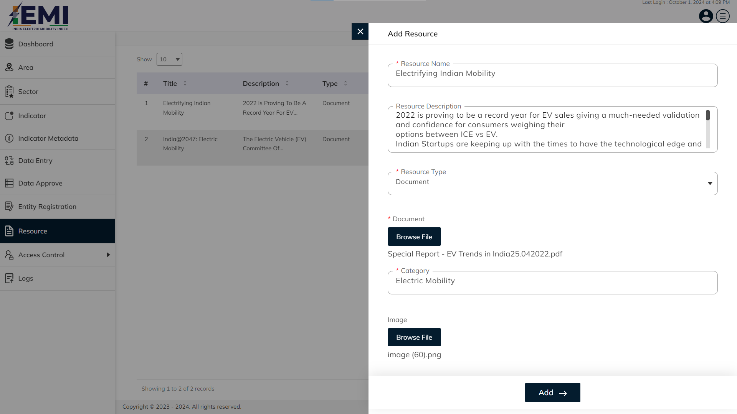
RESOURCE
Enter mandatory details like resource name, resource description, resource type and category. Click on add button to confirm and save.

Slide 53

RESOURCE
Click on the dropdown available under action column to edit, delete and disable the resource.

Slide 54
10
ACCESS CONTROL

Slide 55
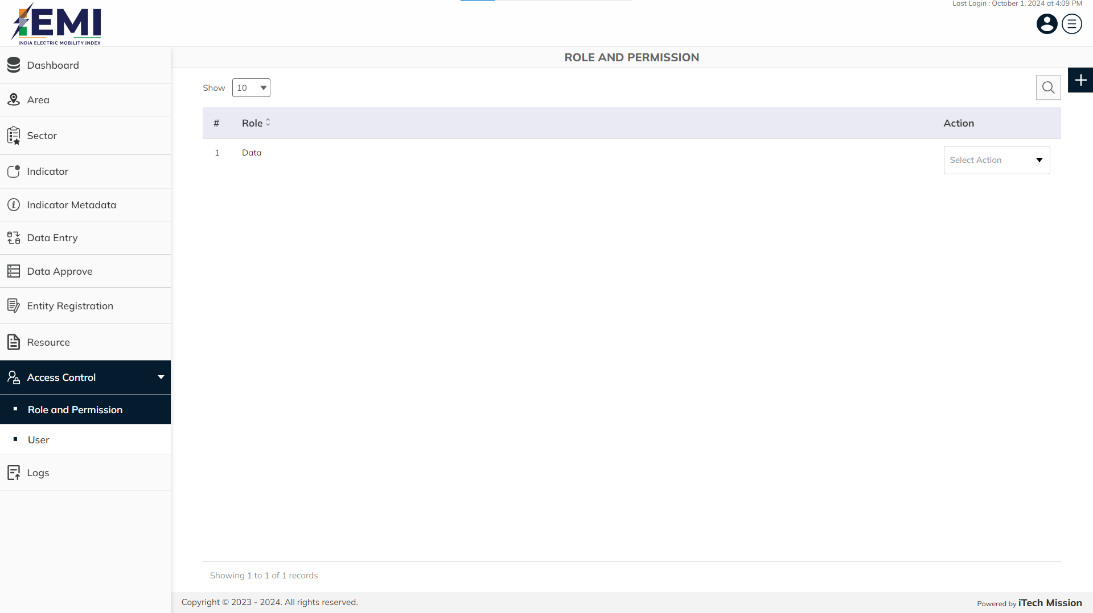
ACCESS CONTROL
View and search existing role from list. Click on plus button to add new role.

Slide 56
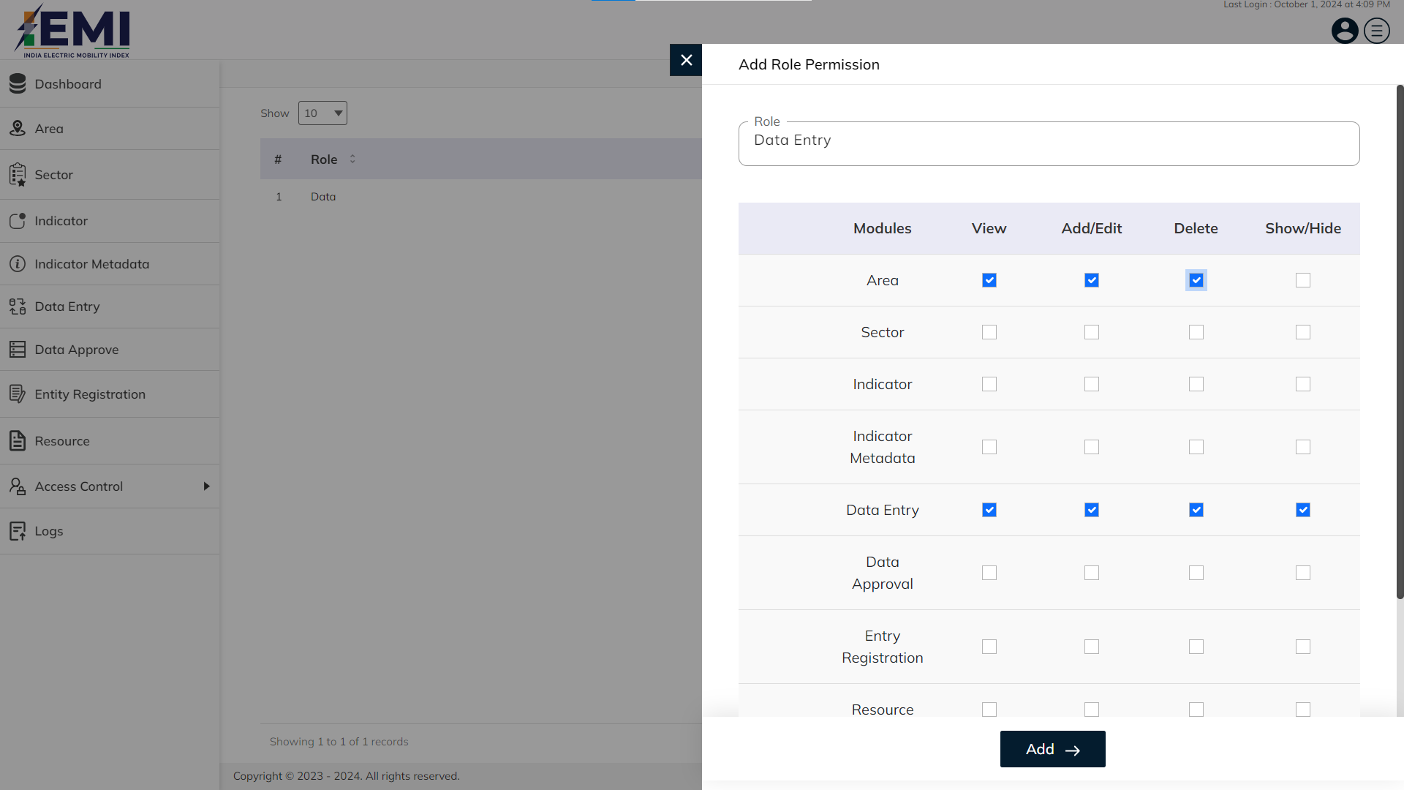
ACCESS CONTROL
Enter required role and select permission for the given modules. Click on add button to confirm and save.

Slide 57
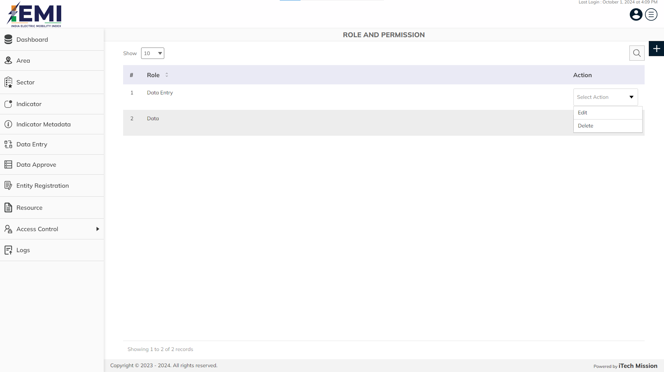
ACCESS CONTROL
Click on the dropdown available under action column to edit and delete the role.

Slide 58
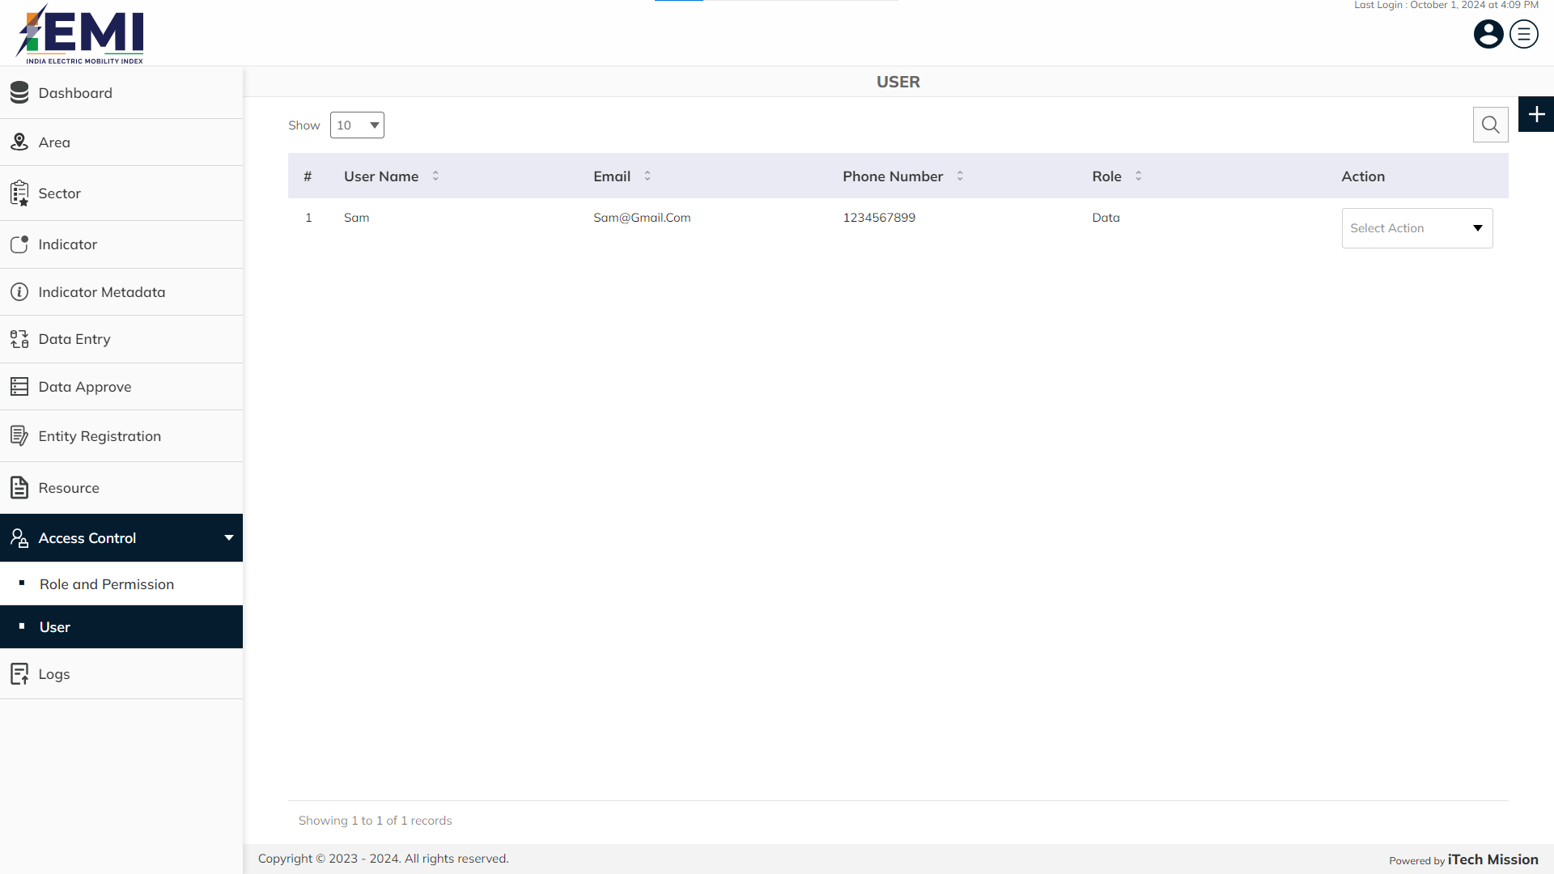
ACCESS CONTROL
View and search existing user list. Click on plus button to add new user.

Slide 59
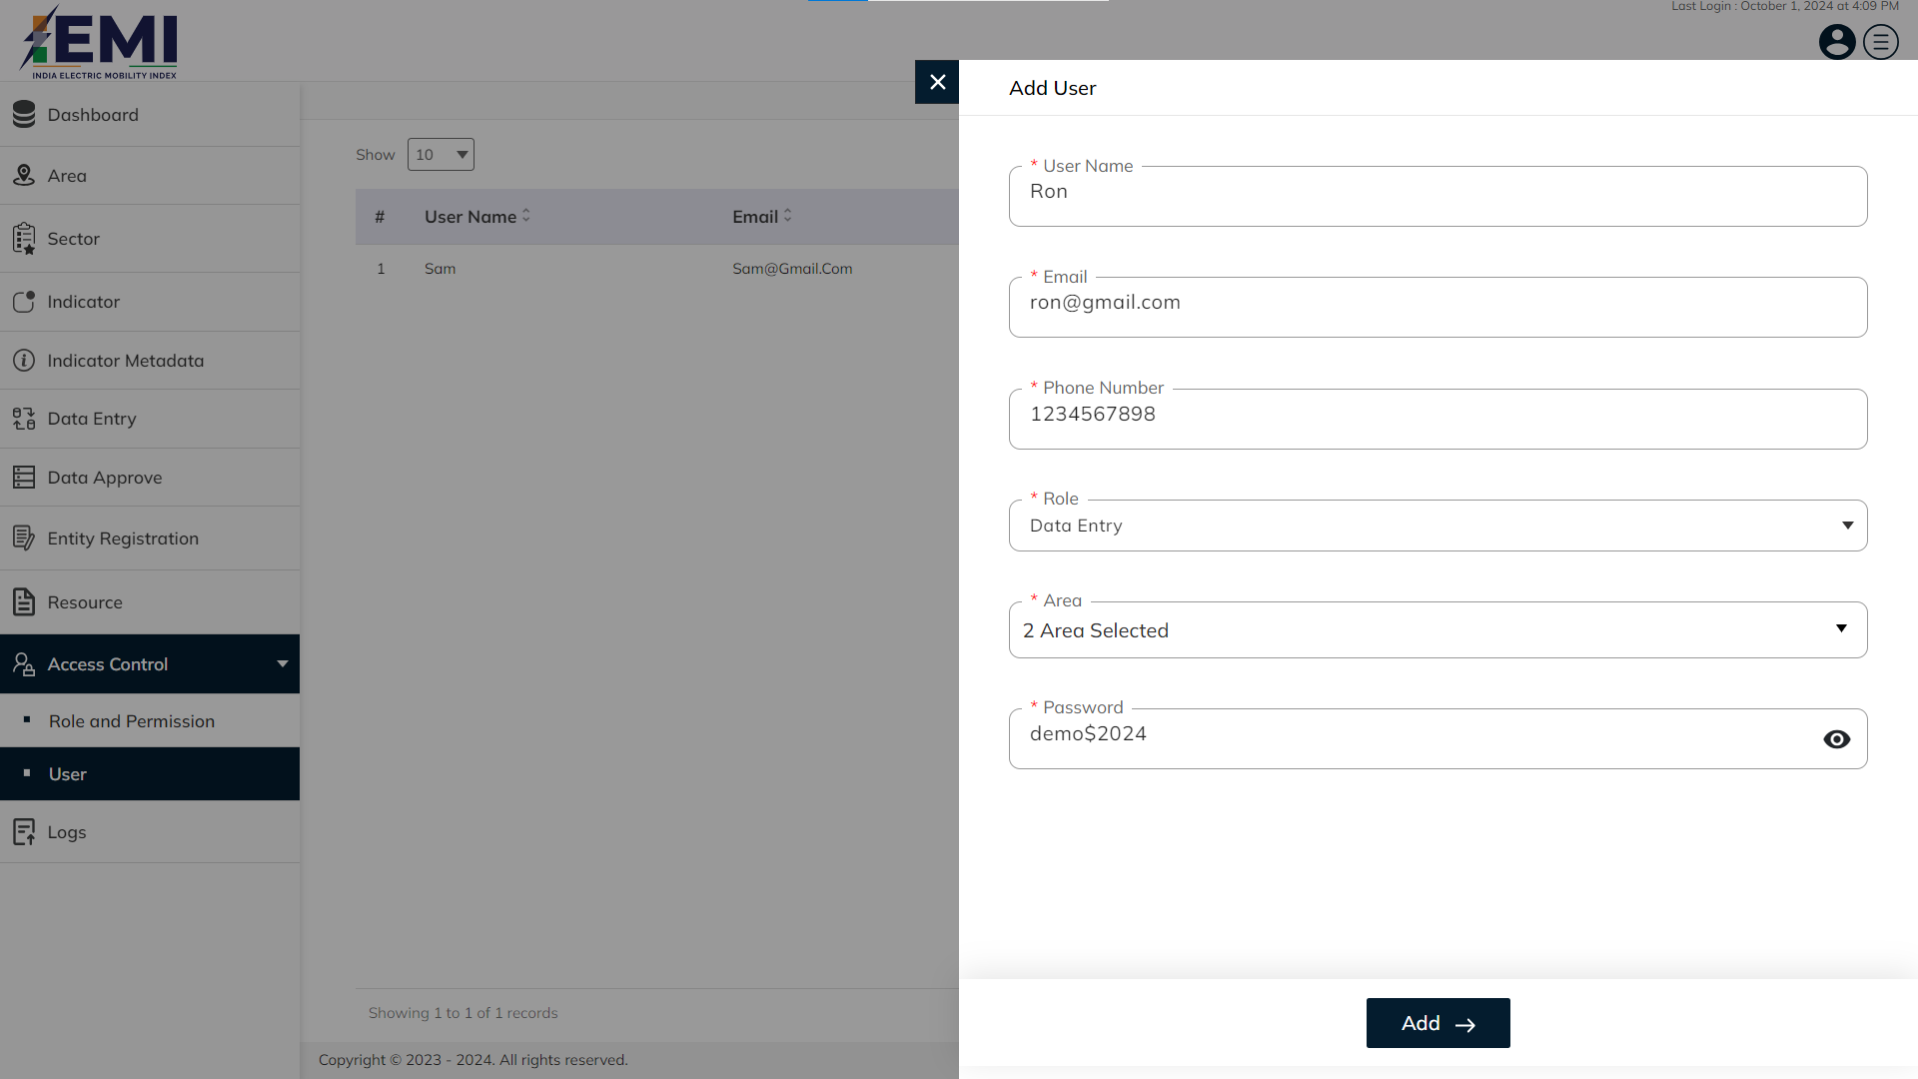
ACCESS CONTROL
Enter mandatory details like User name, email, phone number, role, area and password. Click on add button to confirm and save.

Slide 60
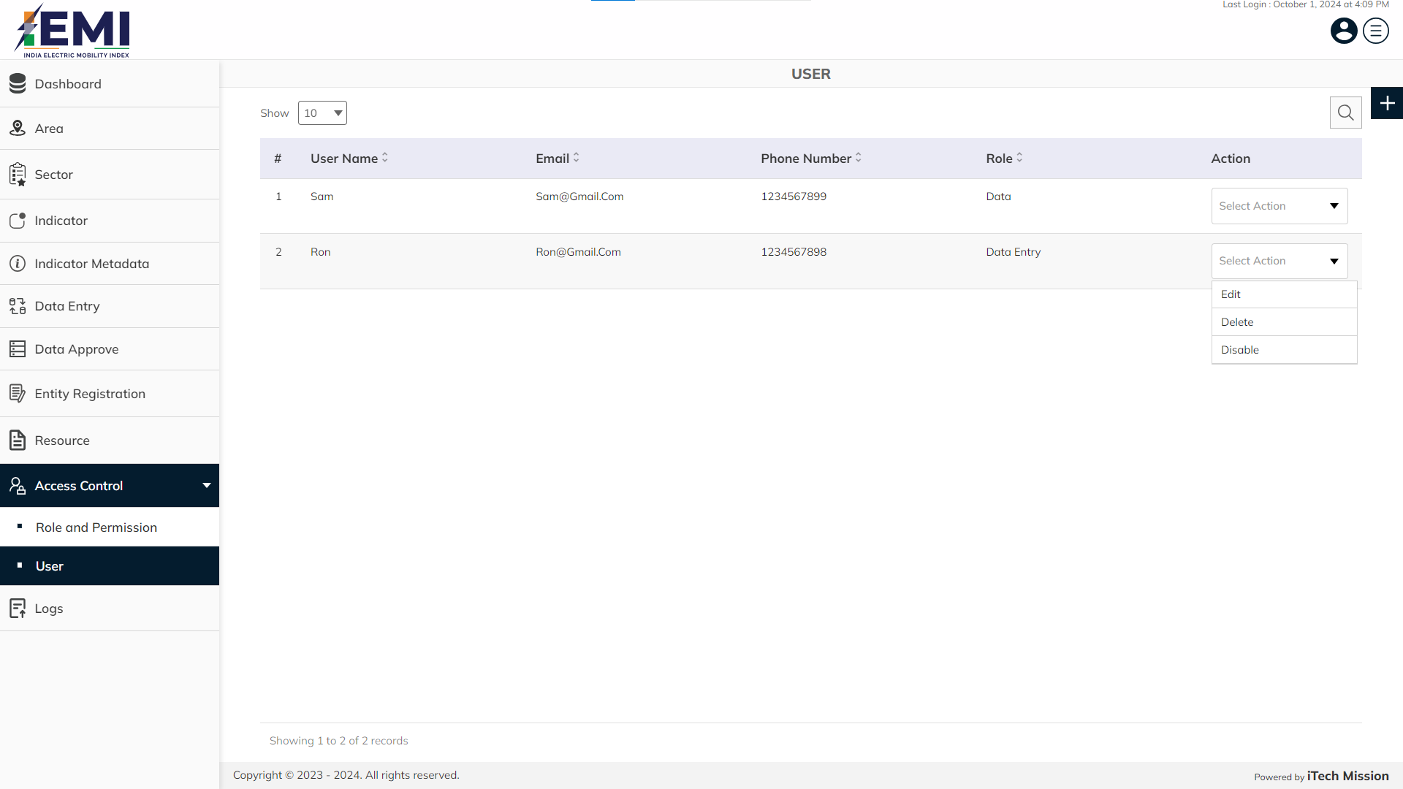
ACCESS CONTROL
Click on the dropdown available under action column to edit, delete and disable the user.

Slide 61
11
LOGS

Slide 62
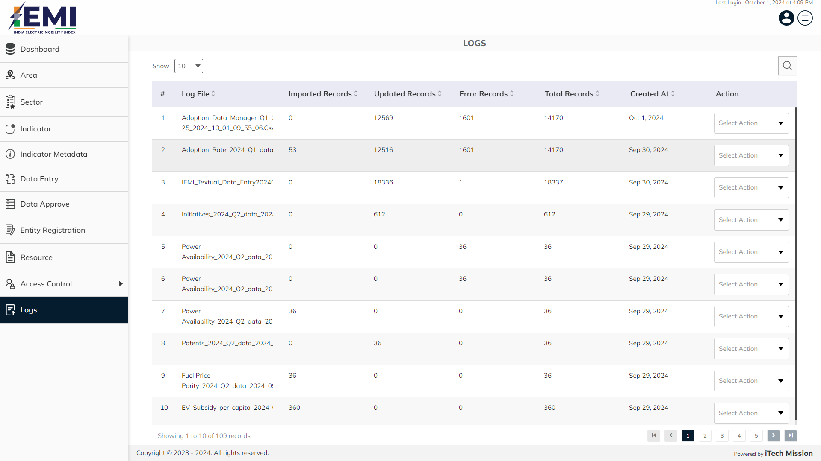
LOGS
View and search existing logs from list.

Slide 63

LOGS
Click on the dropdown available under action column to download and delete the logs.

Slide 64


